Slide 1
Topic Distance and Coherence for Latent Dirichlet Allocation
Renata Chai Sept. 23, 2016
Notes:
This summer I did a research in baylor university with Dr. David Lin about evaluation of factors involved in a specific topic model LDA.
Definition
Tasks
Information Retrieval in daily life
Library – Realistic Example
Topic Model is working in similar ways.
Labeling – Too tedious. How to extract topics from a large collections

Slide 2
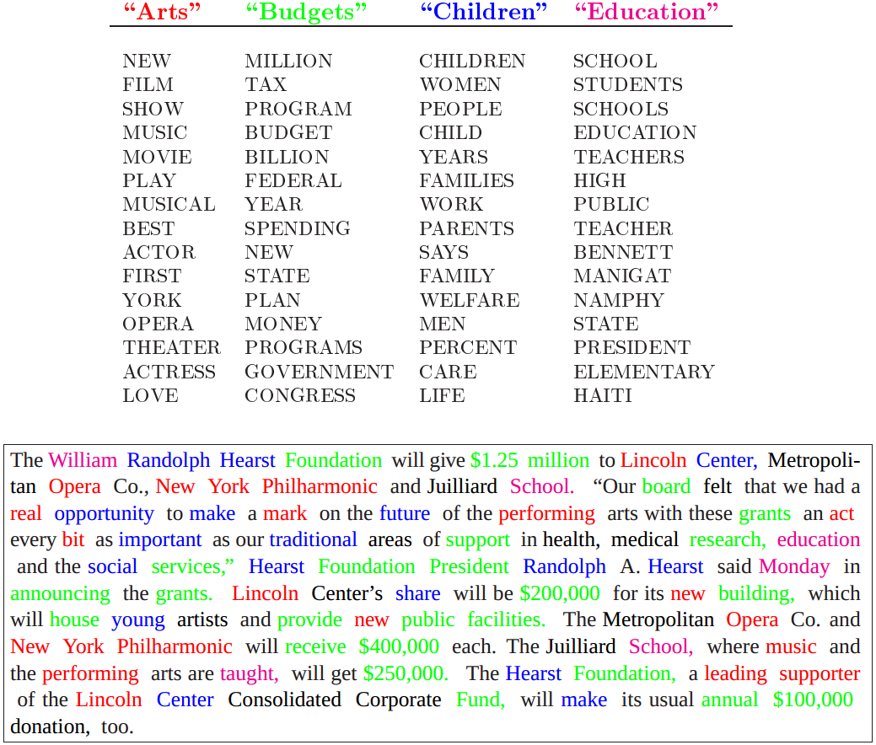
Topic Model
Definition: A tool to extract thematic structures in a discrete data collection.
Notes:
Information retrieval refers to searching in a large data collection according to specific need. If we think about trying to find a book in the library, we first define a specific topic we want to look at and then find a book
As we see in this example, four topics each represents a specific semantic meaning are extracted from the text by a Topic Model
Topic model is not only used for text corpora. It is also used in image categorization and gene processing.

Slide 3
Topic Model
Application
Searching
Classification
Similarity and Relevance Judgment
Summarization
Latent Dirichlet Allocation

Slide 4
Topic Distance
Notes:
We want output topics to have high quality. Two essential features are topic distance and topic coherence.
Topic distance refers to the distinction among topics. Whether each topic represents a unique concept or subject different from other topics.

Slide 5
Topic Distance
Similar Topics
Topic 1
- Program
Algorithm
Command
Computation
Software
Graphics
…
Topic 2
- Software
Algorithm
Command
Engineering
Program
UI
…
Topic 3
- Program
Computation
Command
Computation
UI
Software
…
Topic 4
- Program
Command
Algorithm
Computation
Graphics
Software
…
Notes:
In real application?

Slide 6
Topic Coherence
Coherent Topic
Topic – Computer Science
Program
Algorithm
Command
Computation
Software
Graphics
…
Incoherent Topic
Topic – ?
Program
Planet
Human
Bank
Fish
Olympic
…
Notes:
Topic coherence refers whether a topic conveys a single specific and consistent concept

Slide 7
Motivation
In the usage of LDA, to improve topic distance and coherence
What corpus type should we choose?
What the number of topics should we choose?
To represent a topic, how many top words should we choose?

Slide 8
Experiment
Varied the number of topics, the number of top words, and corpus types
Distance Measures:
Distribution-based distance measures
Ranking - based distance measures
Set-based distance measures
Vector-based distance measures
Coherence Measures:
Co-occurrence based coherence measures
WordNet Topic coherence measures

Slide 9
Outline
Background
Distance Experiments
Coherence Experiments
Discussion

Slide 10
Outline
Background
Corpus Representation
Latent Dirichlet Allocation
Distance Measures
Coherence Measures
Distance Experiments
Coherence Experiments
Discussion

Slide 11
Corpus Representation
Corpus: A collection of documents (i.e. 20000 news collections)
Raw Corpus Input ???
How to use a small amount of information to represent a large corpus?
What features should be extracted to represent a corpus?
What relationships should be kept?
Notes:
A corpus is a large collection of documents. Many information retrieval tasks require a large corpus containing thousands of documents.
For diverse processing on corpora, such as searching, classification … Do we just throw the raw corpus as the input?
That will be very inefficient.
Therefore, representation of a large corpus is needed.
In the representation process, what features and relationships should be extracted?

Slide 12
Corpus Representation
Features:
Discrete units: Words, Documents (A document: a string with >=2 words)
Relationships:
Words belong to documents
Semantical relevance between documents (new or current)
Searching: Relevance between querying strings(new documents) and documents
Relevance Recommendation: Relevance between current documents

Slide 13
Vector Space Model
dq
w1
Vocabulary: All unique words in the corpus.
Each word is given an arbitrary ID
i.e. sun: 1, night: 2, day: 3 … space: z
Vocabulary Space – Each word is a unit vector
d1
wz
θ
α
w2
Document: (1: c₁, 2: c₂, 3: c₃ …… z: c_{z})
w3
d2
Different corpus types use different methods to determine the weight c for each word in a document vector
Notes:
Salton (1971) proposed the vector space model (VSM) for corpus representation.
Each document is represented by a vector in a space and relevance is judged by their positions in the space.
In a given corpus, there is a fixed set of unique words, which is called the vocabulary of the corpus. Suppose there are Z words
Each word is given a unique id from 1 to z.
Each word is a unit vector.
Assume all words are exchangeable
A Z-dimensional vector. A weight value c is given to each word
A corpus is a set of z-dimensional vector

Slide 14
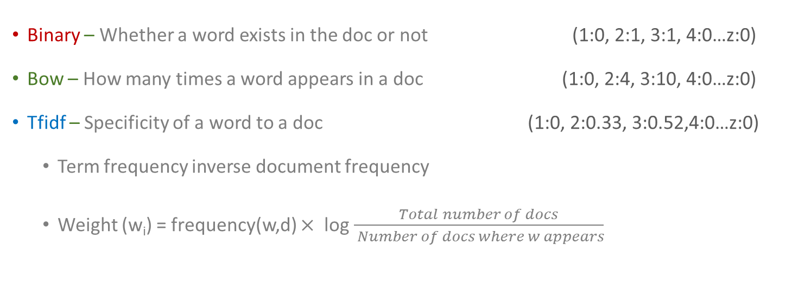
Corpus Types
Binary – Whether a word exists in the doc or not (1:0, 2:1, 3:1, 4:0…z:0)
Bow – How many times a word appears in a doc (1:0, 2:4, 3:10, 4:0…z:0)
Tfidf – Specificity of a word to a doc (1:0, 2:0.33, 3:0.52,4:0…z:0)
Term frequency inverse document frequency
Weight (w_{i}) = frequency(w,d) $×$ log $\frac{Total number of docs}{ Number of docs where w appears}$
Notes:
As you might expect, tfidf corpus type generally captures the semantical structure of documents better than other two corpus types.
And we do expect it to perform better in topic model.
Tfidf corpus type values words that only appear frequently in the current document

Slide 15
Corpus Implementation
Vocabulary: a dictionary {id: word, id: word…}
Document: a list of (word_id, weight value)
words with weight value 0 are ignored in the list
[(1,0.22), (3,0.5), (4,0.3), (27,0.78)…]
Corpus: a list of document

Slide 16
Dimension Reduction
Vocabulary Size: 10,000 ~ 100,000
How to reduce dimension?
Features: Words, Topics, Documents
w1
T1
T1
d1
T2
wz
d2
w2
T2
w3
Tk
Tk
d3
Vector Space: Vocabulary Space -> Topic Space -> Documents
Notes:
We extract a topic space on the vocabulary space and then model documents on topics.
There can be hierarchical levels of topics
We can model each topic as a vector of words and each document as a vector of topics.
FSA -> PDA

Slide 17
Dimension Reduction
Vocabulary Size: 10,000 ~ 100,000
How to reduce dimension?
Features: Words, Topics, Documents
How to extract topics from a corpus? How to define weight values?
Topic (word₁:c₁, w₂:c₂, w₃:c₃….w_{z}:c_{z})
Document (topic₁:c₁, t₂:c₂, t₃:c₃…w_{z}:c_{z})
Vector Space: Vocabulary Space -> Topic Space -> Documents
Notes:
We extract a topic space on the vocabulary space and then model documents on topics.
There can be hierarchical levels of topics
We can model each topic as a vector of words and each document as a vector of topics.
FSA -> PDA

Slide 18
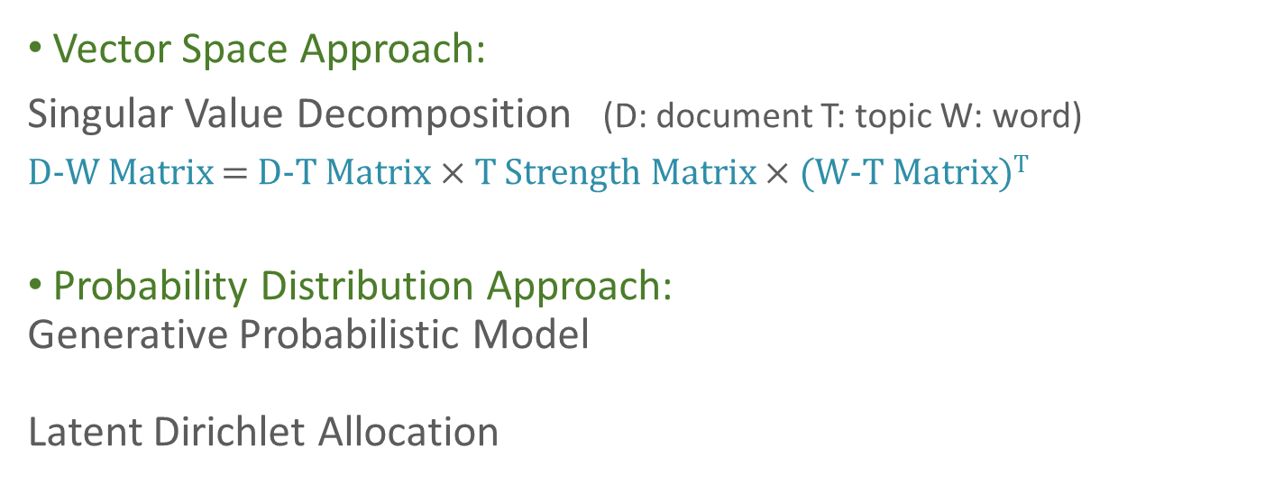
Topic Model
Vector Space Approach:
Singular Value Decomposition (D: document T: topic W: word)
D-W Matrix = D-T Matrix $×$ T Strength Matrix $×$ (W-T Matrix)^{T}
Probability Distribution Approach:
Generative Probabilistic Model
Latent Dirichlet Allocation

Slide 19
Probability Distribution Representation
A topic is a multinomial distribution over the vocabulary
 | Topic 1 | Topic 2 | Topic 3
computer | 0.035 | 8.3e-5 | 2.3e-5
earth | 3.5e-5 | 0.033 | 3.4e-7
file | 0.003 | 3.2e-8 | 1.0e-8
organic | 2.7e-4 | 0.010 | 9.2e-5
planet | 1.9e-9 | 1.3e-7 | 0.012
... | ... | ... | ...
Sum | 1 | 1 | 1
w1
T1
T2
wz
w2
w3
Tk

Slide 20
Probability Distribution Representation
A document is a multinomial distribution over topics
T1
d1
 | Topic 1 | Topic 2 | Topic 3 | Sum
Doc 1 | 0.87 | 0.09 | 0.04 | 1
Doc 2 | 0.05 | 0.92 | 0.03 | 1
… | … | … | …
d2
T2
Tk
d3

Slide 21
Bayes’ Theorem
Balls-> | Red | Blue | Total
Bag 1 | 0.3 | 0.1 | 0.4
Bag 2 | 0.4 | 0.2 | 0.6
Total | 0.7 | 0.3 | 1
Joint Probability
For two random variables A & B, joint probability of A & B is the probability of the co-occurrence of A & B
i.e. P(Red & Bag1) = 0.3
If A and B are independent,
p(A,B) = p(A) x p(B)

Slide 22
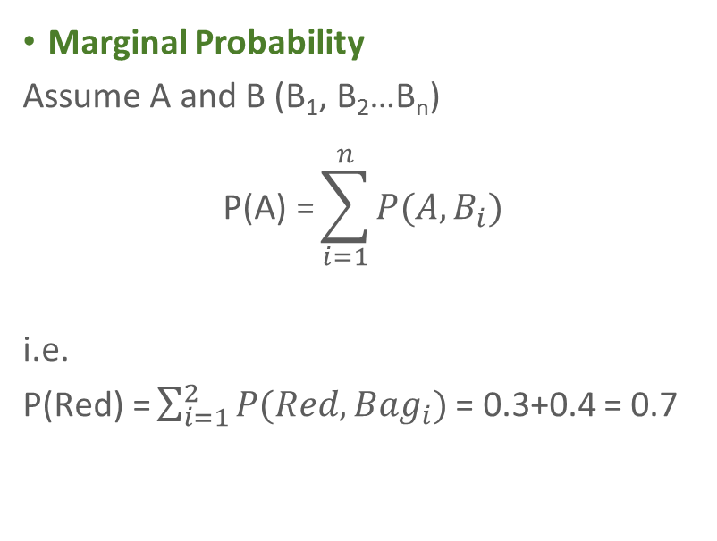
Bayes’ Theorem
Balls-> | Red | Blue | Total
Bag 1 | 0.3 | 0.1 | 0.4
Bag 2 | 0.4 | 0.2 | 0.6
Total | 0.7 | 0.3 | 1
Marginal Probability
Assume A and B (B₁, B₂…B_{n})
$$\text{P}\text{(}\text{A}\text{) =}\sum_{i=1}^{n}{P(A,B_{i})}$$
i.e.
$\text{P}\text{(}\text{Red}\text{) =}\sum_{i=1}^{2}{P(Red, {Bag}_{i})}$ = 0.3+0.4 = 0.7

Slide 23
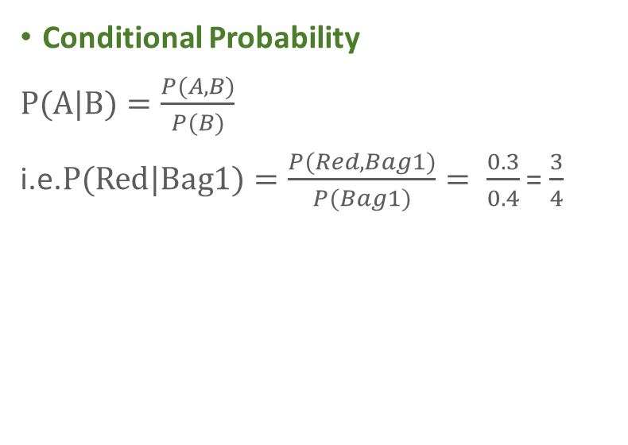
Bayes’ Theorem
Balls-> | Red | Blue | Total
Bag 1 | 0.3 | 0.1 | 0.4
Bag 2 | 0.4 | 0.2 | 0.6
Total | 0.7 | 0.3 | 1
Conditional Probability
$P(A|B)=\frac{P(A, B)}{P(B)}$
i.e.$P(Red|Bag1)=\frac{P(Red, Bag1)}{P(Bag1)}= \frac{0.3}{0.4}$ = $\frac{3}{4}$

Slide 24
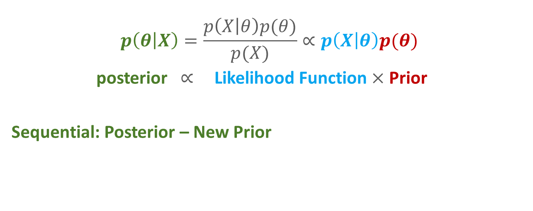
Bayesian Inference
$$p\left(θ | X\right)=\frac{p\left(X | θ\right)p(θ)}{p(X)}∝p\left(X | θ\right)p(θ)$$
posterior $∝$Likelihood Function $×$Prior
Sequential: Posterior – New Prior
Notes:
Posterior is proportional to prior multiplied by likelihood function

Slide 25
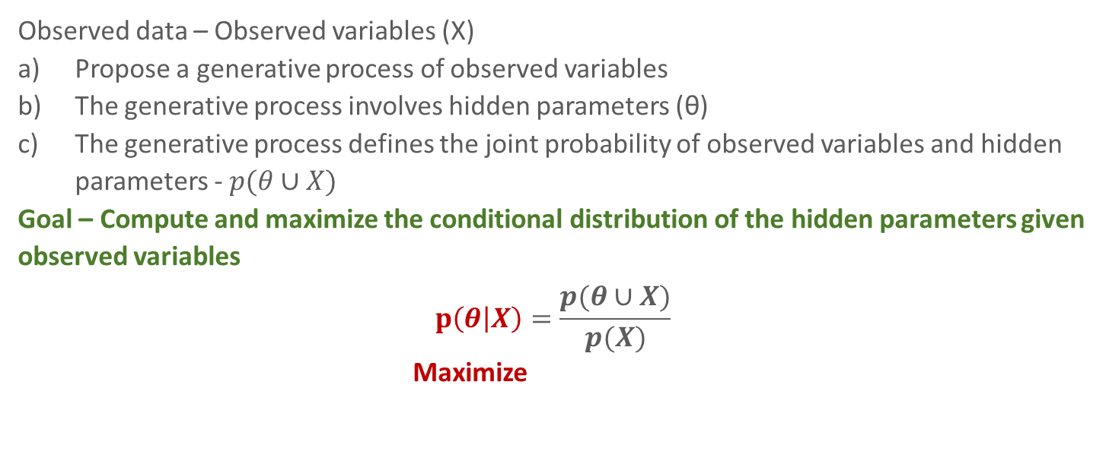
Generative Probabilistic Modeling
Observed data – Observed variables (X)
Propose a generative process of observed variables
The generative process involves hidden parameters (θ)
The generative process defines the joint probability of observed variables and hidden parameters - $p(θ∪X)$
Goal – Compute and maximize the conditional distribution of the hidden parameters given observed variables
$$p\left(θ | X\right)=\frac{p(θ∪X)}{p(X)}$$
Maximize
Notes:
LDA is a generative probabilistic model which has a three-level hierarchical Bayesian structure.

Slide 26
Latent Dirichlet Allocation
A topic is a distribution over the vocabulary
A document is a distribution over topics
Both distributions are generated by dirichlet processes
 | Topic 1 | Topic 2 | Topic 3
computer | 0.035 | 8.3e-5 | 2.3e-5
earth | 3.5e-5 | 0.033 | 3.4e-7
file | 0.003 | 3.2e-8 | 1.0e-8
organic | 2.7e-4 | 0.010 | 9.2e-5
planet | 1.9e-9 | 1.3e-7 | 0.012
program | 0.025 | 9.2e-6 | 7.2e-6
space | 1.3e-8 | 5.4e-6 | 0.008
soil | 5.6e-5 | 0.009 | 4.3e-7
universe | 7.8e-6 | 1.9e-7 | 0.065
... | ... | ... | ...
Topic 1 | Topic 2 | Topic 3
computer program File ... | earth organic soil ... | universe planet space ...
 | Topic 1 | Topic 2 | Topic 3
Doc 1 | 0.87 | 0.09 | 0.04
Doc 2 | 0.05 | 0.92 | 0.03
Notes:
As I mentioned before, a corpus has its own vocabulary, a fixed set of words.
i.e. If you talk about topic1, the probability that the word computer will be mentioned is 0.035 whereas the probability that planet will be mentioned is very close to zero. So we can interpret that topic1 is related with computer programs
And all values in each column sum to one.
i.e. If you write document1, the probability that topic1 will be mentioned is 0.87

Slide 27
Latent Dirichlet Allocation
Doc 1: computer program…
Doc 2: earth soil…
Doc 3: sun universe…
Doc 4: …
…
Doc m: ...
 | Topic 1 | Topic 2 | Topic 3
computer | 0.035 | 8.3e-5 | 2.3e-5
earth | 3.5e-5 | 0.033 | 3.4e-7
file | 0.003 | 3.2e-8 | 1.0e-8
organic | 2.7e-4 | 0.010 | 9.2e-5
planet | 1.9e-9 | 1.3e-7 | 0.012
program | 0.025 | 9.2e-6 | 7.2e-6
space | 1.3e-8 | 5.4e-6 | 0.008
soil | 5.6e-5 | 0.009 | 4.3e-7
universe | 7.8e-6 | 1.9e-7 | 0.065
... | ... | ... | ...
 | Topic 1 | Topic 2 | Topic 3
Doc 1 | 0.87 | 0.09 | 0.04
Doc 2 | 0.05 | 0.92 | 0.03
… | … | … | …
Notes:
In real life, to write a document, a writer will first have one or several topics in mind, then organize the document around those topics, in other word, choosing words related with the topic.
LDA abstracts this generative process.
LDA assumes that a corpus is a combination of words randomly sampled based on these two distributions

Slide 28
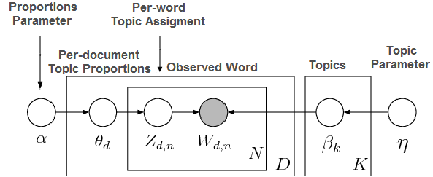
LDA - Corpus Generation Process
𝜷_{k}: A topic/A probability distribution over the vocabulary
There are K 𝜷
 | Topic 1 | Topic 2 | Topic 3
computer | 0.035 | 8.3e-5 | 2.3e-5
earth | 3.5e-5 | 0.033 | 3.4e-7
file | 0.003 | 3.2e-8 | 1.0e-8
organic | 2.7e-4 | 0.010 | 9.2e-5
planet | 1.9e-9 | 1.3e-7 | 0.012
program | 0.025 | 9.2e-6 | 7.2e-6
space | 1.3e-8 | 5.4e-6 | 0.008
soil | 5.6e-5 | 0.009 | 4.3e-7
universe | 7.8e-6 | 1.9e-7 | 0.065
... | ... | ... | ...
Notes:
To generate a corpus, LDA assumes that there exists a set of topics.
Beta k refers to a specific topic, in other words, a probability distribution over the vocabulary
There are K beta
Eta is a parameter for dirichlet process.

Slide 29
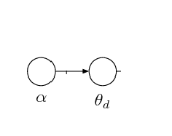
LDA - Corpus Generation Process
To generate a document, a probability distribution over topics 𝜽_{d} is generated
 | Topic 1 | Topic 2 | Topic 3
Doc 1 | 0.87 | 0.09 | 0.04

Slide 30
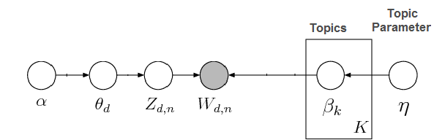
LDA - Corpus Generation Process
To generate a word in the document:
Based on 𝜽_{d}, a topic Z is selected
Based on 𝜷_{z}, a word W is selected
Topic 1
Computer: 0.035 Program: 0.025 File: 0.003 ...
 | Topic 1 | Topic 2 | Topic 3
Doc 1 | 0.87 | 0.09 | 0.04
program

Slide 31
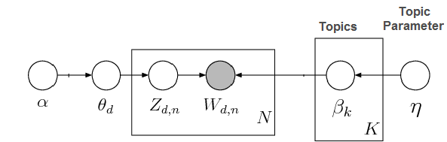
LDA - Corpus Generation Process
Repeat N Times
Doc 1: program file earth command...

Slide 32
LDA - Corpus Generation Process
Repeat D times (Doc1, Doc2, Doc3….)

Slide 33
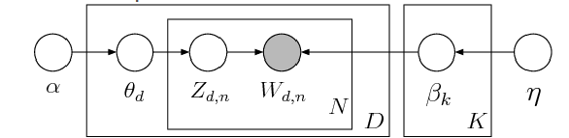
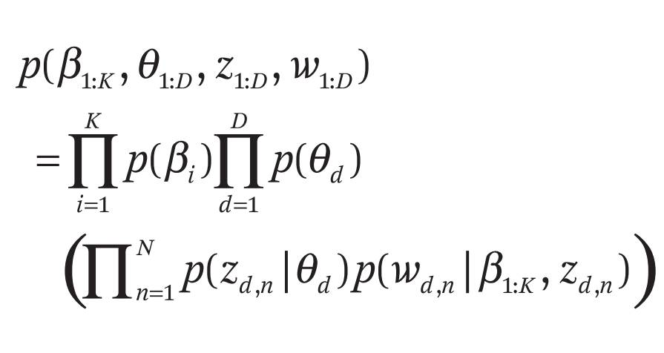
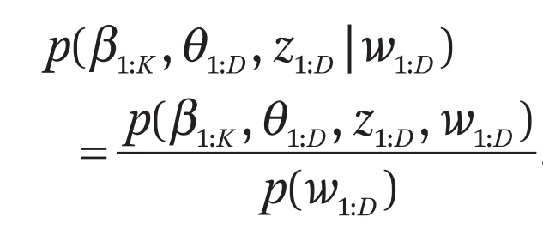
LDA - Inference Process
What we want/hidden : β_{1:K}, θ_{1:D}, z_{1:D}
What we know/observed: w_{1:D}
β_{1:K}, θ_{1:D}, z_{1:D} could not be directly computed

Slide 34
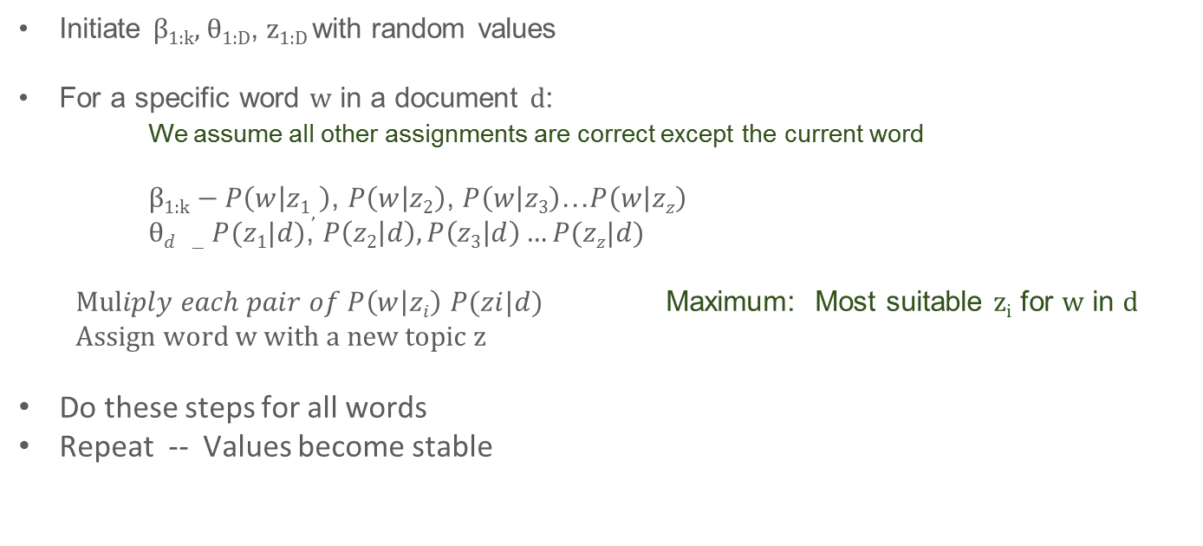
LDA – Gibbs Sampling
Initiate β_{1:k}, θ_{1:D}, z_{1:D} with random values
For a specific word w in a document d:
We assume all other assignments are correct except the current word
$\text{β}\text{1:}\text{k}−P\left(w | z1, \right)$, $P\left(w | z2\right)$, $P\left(w | z3\right)$…$P\left(w | zz\right)$
$\text{θ}d −P(z1|d)$, $P\left(z2 | d\right),P\left(z3 | d\right)…P(zz|d)$
$Muliply each pair of P\left(w | zi\right)$ $P(zi|d)$ Maximum: Most suitable z_{i} for w in d
Assign word w with a new topic z
Do these steps for all words
Repeat -- Values become stable
Notes:
There are many approximation process that calculate the most likely beta, theta and z.
This is a simplified introduction of LDA. There are omissions of conditions in all these formulas. If you are interested in LDA, check Blei’s paper.

Slide 35
Implementation
 | Topic 1 | Topic 2 | Topic 3
computer | 0.035 | 8.3e-5 | 2.3e-5
earth | 3.5e-5 | 0.033 | 3.4e-7
file | 0.003 | 3.2e-8 | 1.0e-8
organic | 2.7e-4 | 0.010 | 9.2e-5
planet | 1.9e-9 | 1.3e-7 | 0.012
... | ... | ... | ...
Corpus represented in VSM
Dirichlet parameters
LDA
Inference
 | Topic 1 | Topic 2 | Topic 3
Doc 1 | 0.87 | 0.09 | 0.04
Doc 2 | 0.05 | 0.92 | 0.03
… | … | … | …

Slide 36
Research Questions
In the implementation of LDA, there are several uncertain variables.
1. K? How would the number of topics influence topic distance and coherence?
Notes:
In real life, if there are less topics, the semantical meaning might not be fully captured. But if there are too many topics, some topics might be pretty similar.
Would the number of topics influence topic model in the same way?
If yes, how to we find the most suitable number of topics?

Slide 37
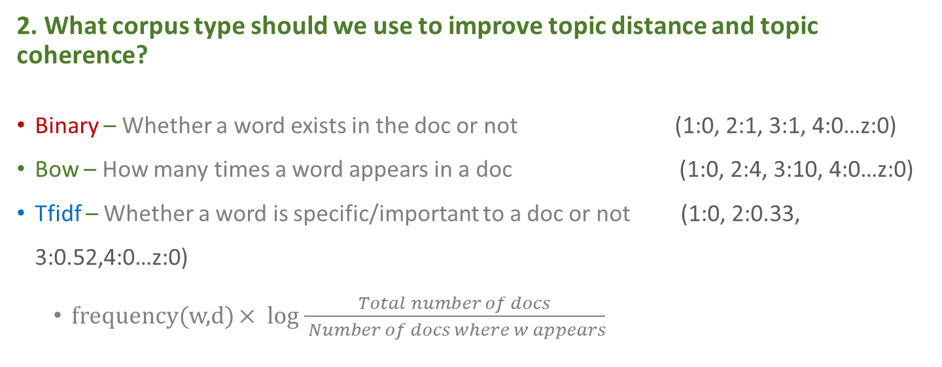
Research Questions
2. What corpus type should we use to improve topic distance and topic coherence?
Binary – Whether a word exists in the doc or not (1:0, 2:1, 3:1, 4:0…z:0)
Bow – How many times a word appears in a doc (1:0, 2:4, 3:10, 4:0…z:0)
Tfidf – Whether a word is specific/important to a doc or not (1:0, 2:0.33, 3:0.52,4:0…z:0)
frequency(w,d) $×$ log $\frac{Total number of docs}{ Number of docs where w appears}$
Notes:
The original paper used bow corpus and most application of LDA used bow corpus also. Some people tried tfidf corpus and get opposite results. Binary corpus is rarely used in LDA. We want to test how these three corpus types influence LDA.

Slide 38
Research Questions
3. To present a topic, how many words should be used to maximize coherence?
Topic x
- Program
Algorithm
Command
Topic x
- Program
Algorithm
Command
Computation
Topic x
- Program
Algorithm
Command
Computation
Software
Human
Graphics
Topic x
- Program
Algorithm
Command
Computation
Software
Human
Graphics
Mark
Template
Interface

Slide 39
Topic Representation
A vector on the vocabulary space
i.e. (0.034, 0.031, 0.029, 0.023…)
A distribution over words
i.e. (school:0.034, student: 0.031, assignment:0.029, education:0.023…)
A ranked list of words
i.e. (school, student, assignment, education) ranked by distribution values
A set of top words
i.e. (student, education, assignment, school)
……

Slide 40
Similarity/Distance Measures
Vector Representation: Cosine Distance
Distribution Representation:
Bha.(Bhattacharyya) Distance - KL(Kullback–Leibler) Divergence
Ranking Representation: Kendall’s Tau
Set Representation: Jaccard Distance

Slide 41
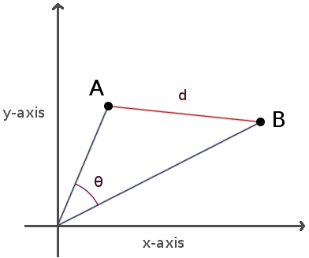
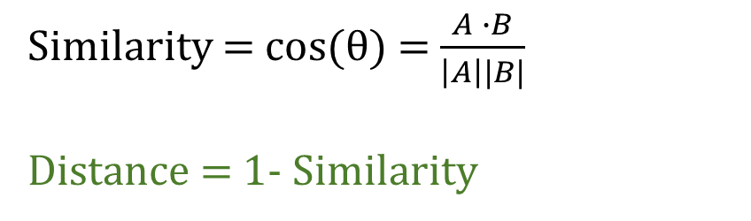
Cosine Similarity and Distance
Calculate similarity between two vectors.
For vector A and vector B:
Similarity = cos(θ) = $\frac{A ∙B}{\left|A\right||B|}$
Distance = 1- Similarity
Distance Range: 0 (θ=0) – 2 (θ=180)

Slide 42
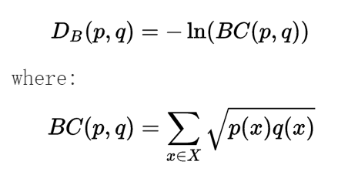
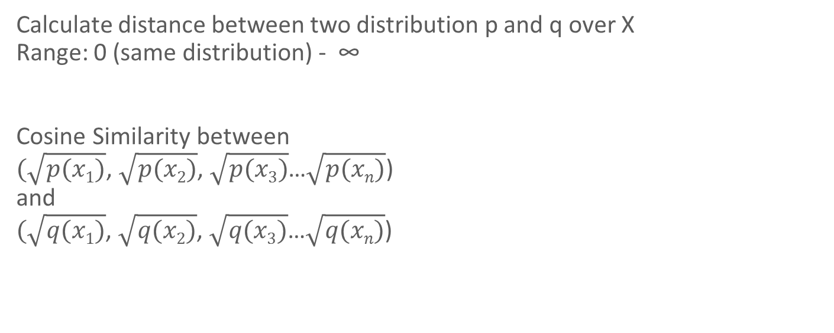
Bha.(Bhattacharyya) distance
Calculate distance between two distribution p and q over X
Range: 0 (same distribution) - ∞
Cosine Similarity between
$(\sqrt{p(x1)}$, $\sqrt{p(x2)}$, $\sqrt{p(x3)}$…$\sqrt{p(xn)}$)
and
$(\sqrt{q(x1)}$, $\sqrt{q(x2)}$, $\sqrt{q(x3)}$…$\sqrt{q(xn)}$)

Slide 43

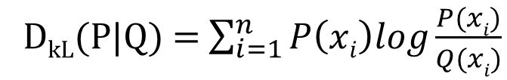
KL Divergence
Compute similarity between two distribution P and Q over X(x₁, x₂…x_{n})
Range: 0(same distribution) - ∞
D_{kL}(P|Q) = $\sum_{i=1}^{n}{P\left(xi\right)log\frac{P(xi)}{Q(xi)}}$
D_{KL} Symmetric = $\frac{\text{D}\text{kL}\text{(}\text{P}\text{|}\text{Q}\text{) + }\text{Dkl}\text{(}\text{Q}\text{|}\text{P}\text{) }}{2}$

Slide 44
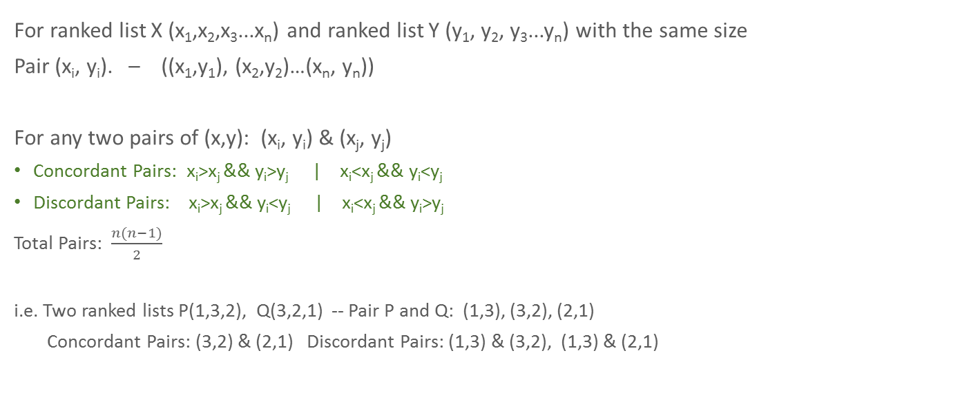
Kendall’Tau Rank Correlation
For ranked list X (x₁,x₂,x₃...x_{n}) and ranked list Y (y₁, y₂, y₃...y_{n}) with the same size
Pair (x_{i}, y_{i}). – ((x₁,y₁), (x₂,y₂)…(x_{n}, y_{n}))
For any two pairs of (x,y): (x_{i}, y_{i}) & (x_{j}, y_{j})
Concordant Pairs: x_{i}>x_{j} && y_{i}>y_{j} | x_{i}<x_{j} && y_{i}<y_{j}
Discordant Pairs: x_{i}>x_{j} && y_{i}<y_{j} | x_{i}<x_{j} && y_{i}>y_{j}
Total Pairs: $\frac{n(n−1)}{2}$
i.e. Two ranked lists P(1,3,2), Q(3,2,1) -- Pair P and Q: (1,3), (3,2), (2,1)
Concordant Pairs: (3,2) & (2,1) Discordant Pairs: (1,3) & (3,2), (1,3) & (2,1)

Slide 45
Kendall’s Tau Rank Correlation
Kendall’s Tau coefficient:
Range: -1(negative correlation) - 1(positive correlation)
Τ = $\frac{\left(number of concordant pairs\right)−(number of discordant pairs)}{n(n−1)/2}$
Notes:
I should reverse the value. We need to be careful in the results part, all interpretation of kendall tau will be reversed.

Slide 46
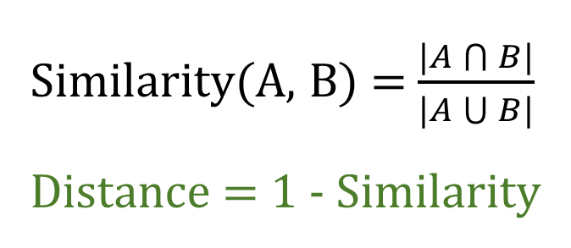
Jaccard Similarity and Distance
Compute similarity between two sets of elements
We choose top 500 words for each topic.
Distance Range: 0(same) – 1(no common elements)
Similarity(A, B) = $\frac{|A\bigcap{B}|}{|A\bigcup{B|}}$
Distance = 1 - Similarity

Slide 47
Topic Coherence Measures
Represent a topic as a set of words with top distributions
Co-occurrence based topic coherence measure
WordNet topic coherence measure

Slide 48
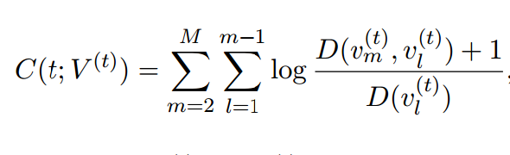
Co-occurrence Based Coherence Measure
For any two words v_{l} and v_{m} in the topic:
Document Frequency D(v_{l}) : the number of documents that contain v_{l}
Co-occurrence Document Frequency D(v_{l}, v_{m}) : the number of documents that contain both v_{l} and v_{m}
Notes:
The summary of co-occurrence document frequency/divided by single word document frequency for all word pairs

Slide 49
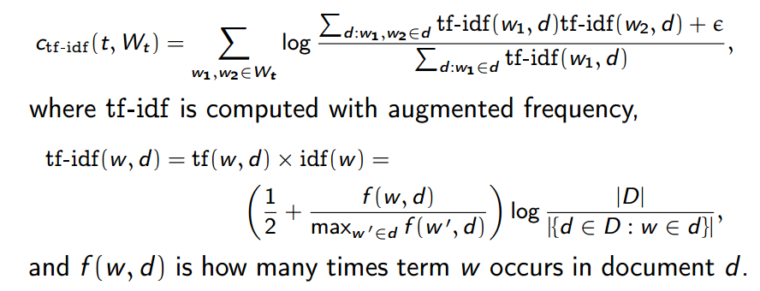
Tfidf Co-occurrence Based Coherence Measure

Slide 50
WordNet Coherence Measure
A collection of English words. - A graph of synsets
A synset represents a specific semantical concept
Synset _____many to many_____Word
Engineer:
Noun
S: (n) engineer, applied scientist, technologist (a person who uses scientific knowledge to solve practical problems)
S: (n) engineer, locomotive engineer, railroad engineer, engine driver (the operator of a railway locomotive)
Verb
S: (v) engineer (design as an engineer) "He engineered the water supply project"
S: (v) mastermind, engineer, direct, organize, organise, orchestrate (plan and direct (a complex undertaking)) "he masterminded the robbery"

Slide 51
WordNet Coherence Measure
Synsets are connected by different relationships:
Hierarchical:
Hypernyms: carnivore is a hypernym of dog
Hyponyms: dog is a hyponym of carnivore
Horizontal:
Antonym: able, unable
Pertainym: academic, academia
There are many other horizontal relationships

Slide 52
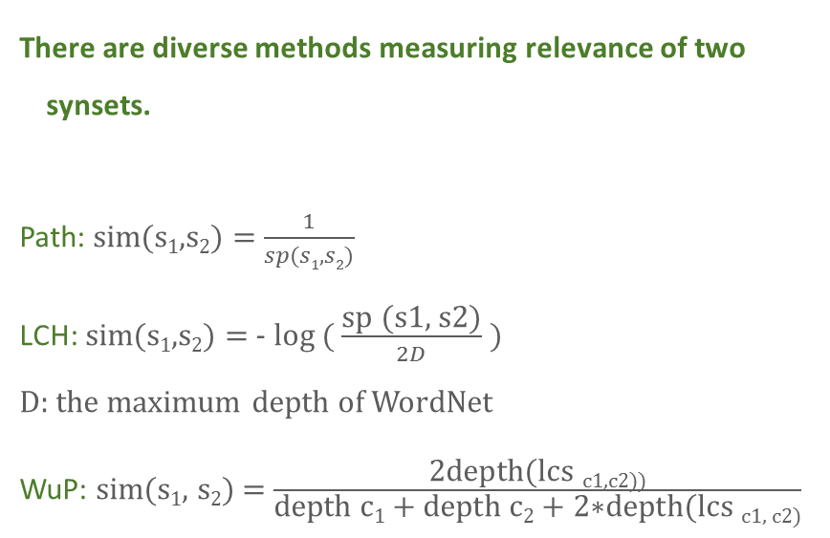
WordNet Coherence Measure
There are diverse methods measuring relevance of two synsets.
Path: sim(s₁,s₂) = $\frac{1}{sp(s1,s2)}$
LCH: sim(s₁,s₂) = - log ( $\frac{\text{sp}\text{ (}\text{s}\text{1}\text{, }\text{s}\text{2}\text{)}}{2D}$ )
D: the maximum depth of WordNet
WuP: sim(s₁, s₂) = $\frac{\text{2}\text{depth}\text{(}\text{lcs} \text{c}\text{1}\text{,}\text{c}\text{2}\text{))}}{\text{depth} \text{c}\text{1} \text{+ }\text{depth} \text{c}\text{2} \text{+ }\text{2}\text{∗}\text{depth}\text{(}\text{lcs} \text{c}\text{1}\text{, }\text{c}\text{2}\text{)}}$
LCS (The least common subsumer): The most specific node in the hierarchy that subsumes both synsets
Animmal
Carnivore
Feline Canine
Cat Dog
…..

Slide 53
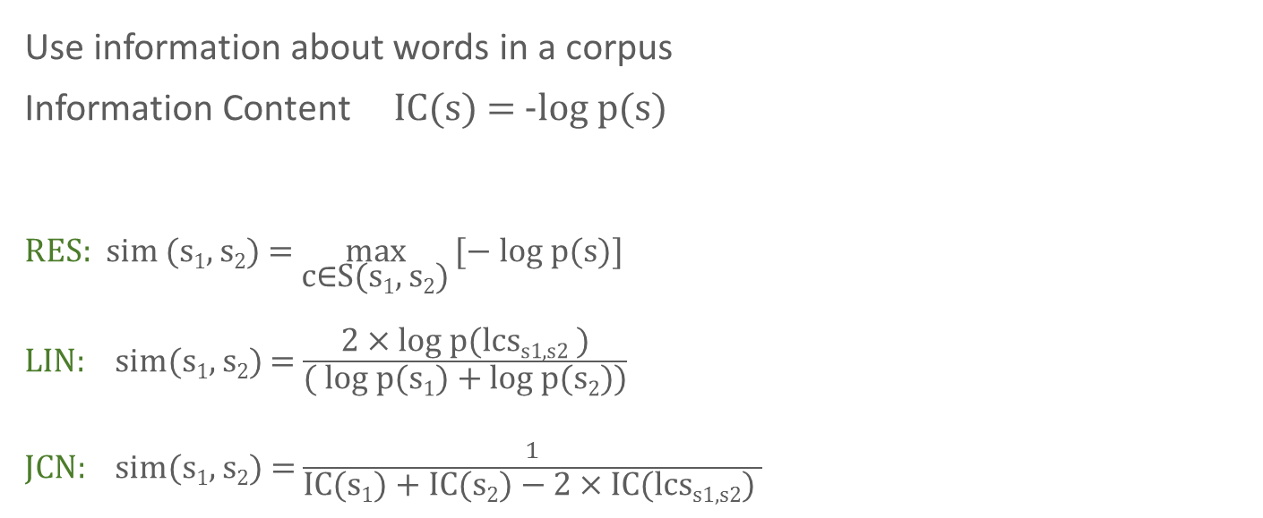
WordNet Coherence Measure
Use information about words in a corpus
Information Content IC(s) = -log p(s)
RES: sim (s₁, s₂) = $\max_{\text{c}\text{∈}\text{S}\text{(}\text{s}\text{1}\text{,} \text{s}\text{2}\text{)}}{\text{[}\text{− }\text{log} \text{p}\text{(}\text{s}\text{)] }}$
LIN: sim(s₁, s₂) = $\frac{\text{2 }\text{× }\text{log} \text{p}\text{(}\text{lcs}\text{s}\text{1}\text{,}\text{s}\text{2} \text{)}}{\text{( }\text{log} \text{p}\text{(}\text{s}\text{1}\text{) + }\text{log} \text{p}\text{(}\text{s}\text{2}\text{))}}$
JCN: sim(s₁, s₂) = $\frac{1}{\text{IC}\text{(}\text{s}\text{1}\text{) + }\text{IC}\text{(}\text{s}\text{2}\text{) }\text{− }\text{2 }\text{× }\text{IC}\text{(}\text{lcs}\text{s}\text{1}\text{,}\text{s}\text{2}\text{) }}$

Slide 54
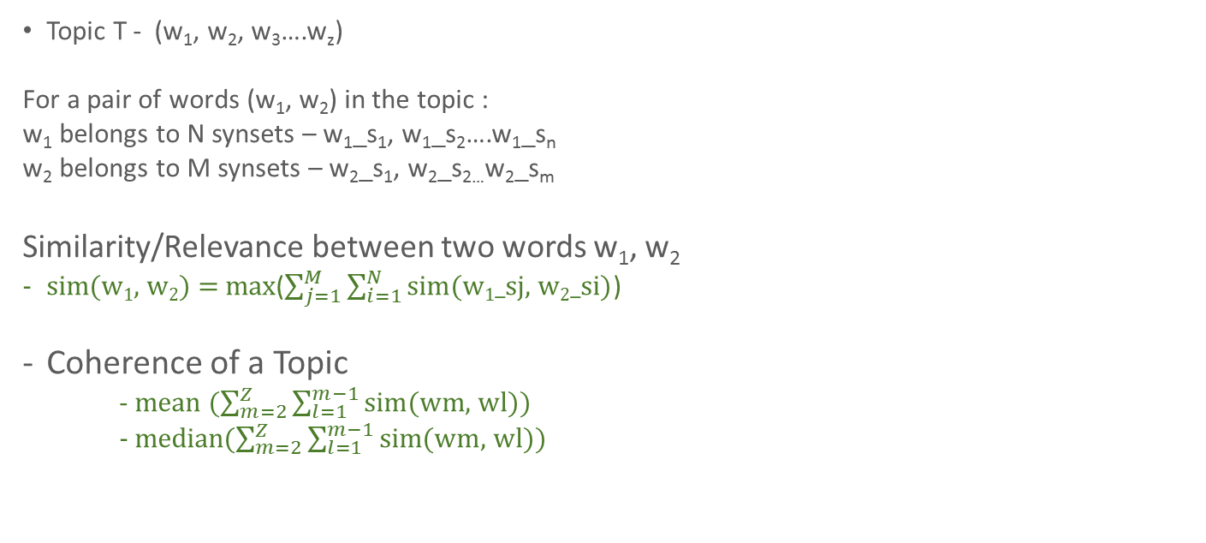
WordNet Coherence Measure
Topic T - (w₁, w₂, w₃….w_{z})
For a pair of words (w₁, w₂) in the topic :
w₁ belongs to N synsets – w₁_s₁, w₁_s₂….w₁_s_{n}
w₂ belongs to M synsets – w₂_s₁, w₂_s_{2…}w₂_s_{m}
Similarity/Relevance between two words w₁, w₂
sim(w₁, w₂) = max($\sum_{j=1}^{M}{\sum_{i=1}^{N}{\text{sim}\text{(}\text{w}\text{1}\text{_}\text{sj}\text{, }\text{w}\text{2}\text{_}\text{si}\text{)}}}$)
Coherence of a Topic
- mean ($\sum_{m=2}^{Z}{\sum_{l=1}^{m−1}{\text{sim}\text{(}\text{wm}\text{, }\text{wl}\text{))}}}$
- median($\sum_{m=2}^{Z}{\sum_{l=1}^{m−1}{\text{sim}\text{(}\text{wm}\text{, }\text{wl}\text{))}}}$

Slide 55
Outline
Background
Distance Experiments
How the number of topics influence distance
How corpus types influence distance
Correlations among results from different measures
Coherence Experiments
Discussion

Slide 56

Packages
NLTK
Natural Language Toolkit
Natural Language Processing Functions
Python
Gensim
Topic Modeling Algorithms
Python

Slide 57
Materials
Two corpora
Reuters:
News collection
90 categories: jobs, housing, coffee, gas, wheat…
10788 Files
Vocabulary size: 26518
Brown:
Literature collection
16 categories: romance, humor, adventure, ...
500 Files
Vocabulary Size: 36450

Slide 58
Preprocessing
Tokenization
Tagging w1/Noun w2/Verb …
Lemmatization - WordNetLematizer
Words Can’t be lemmatized - > Stemming removing ing, es, s, ed…
RE Matching
Tokens with letters,
Numbers/Hyphens embedded in tokens i.e. H2O, two-year
Abbreviations i.e. U.S.A
Removing Stop Words i.e. is then when

Slide 59
Distance Experiment
Corpus Name | Reuters | Brown
Topic Numbers: | 10 20 30 40 50 | 12 14 16 18 20
Corpus Type | tfidf, bow, binary
Measures | Cosine Distance Bhattacharyya Distance KL Divergence Jaccard Distance Kendall’s Tau Correlation

Slide 60
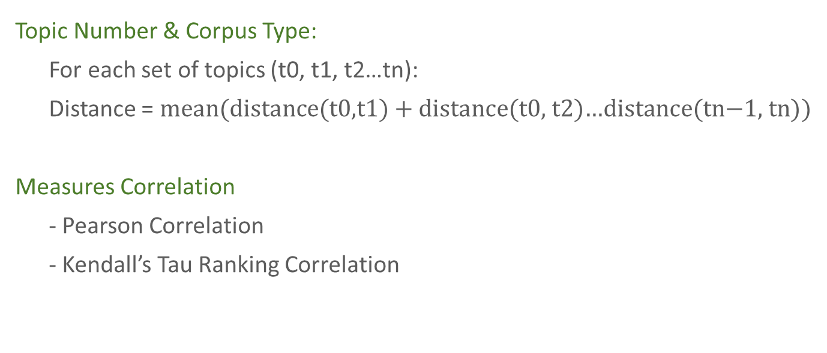
Distance Experiment
Topic Number & Corpus Type:
For each set of topics (t0, t1, t2…tn):
Distance = mean($distance\text{(}\text{t}\text{0,}\text{t}\text{1) + }\text{distance}\text{(}\text{t}\text{0,} \text{t}\text{2)…}\text{distance}\text{(}\text{tn}\text{−1, }\text{tn}\text{)}$)
Measures Correlation
- Pearson Correlation
- Kendall’s Tau Ranking Correlation

Slide 61
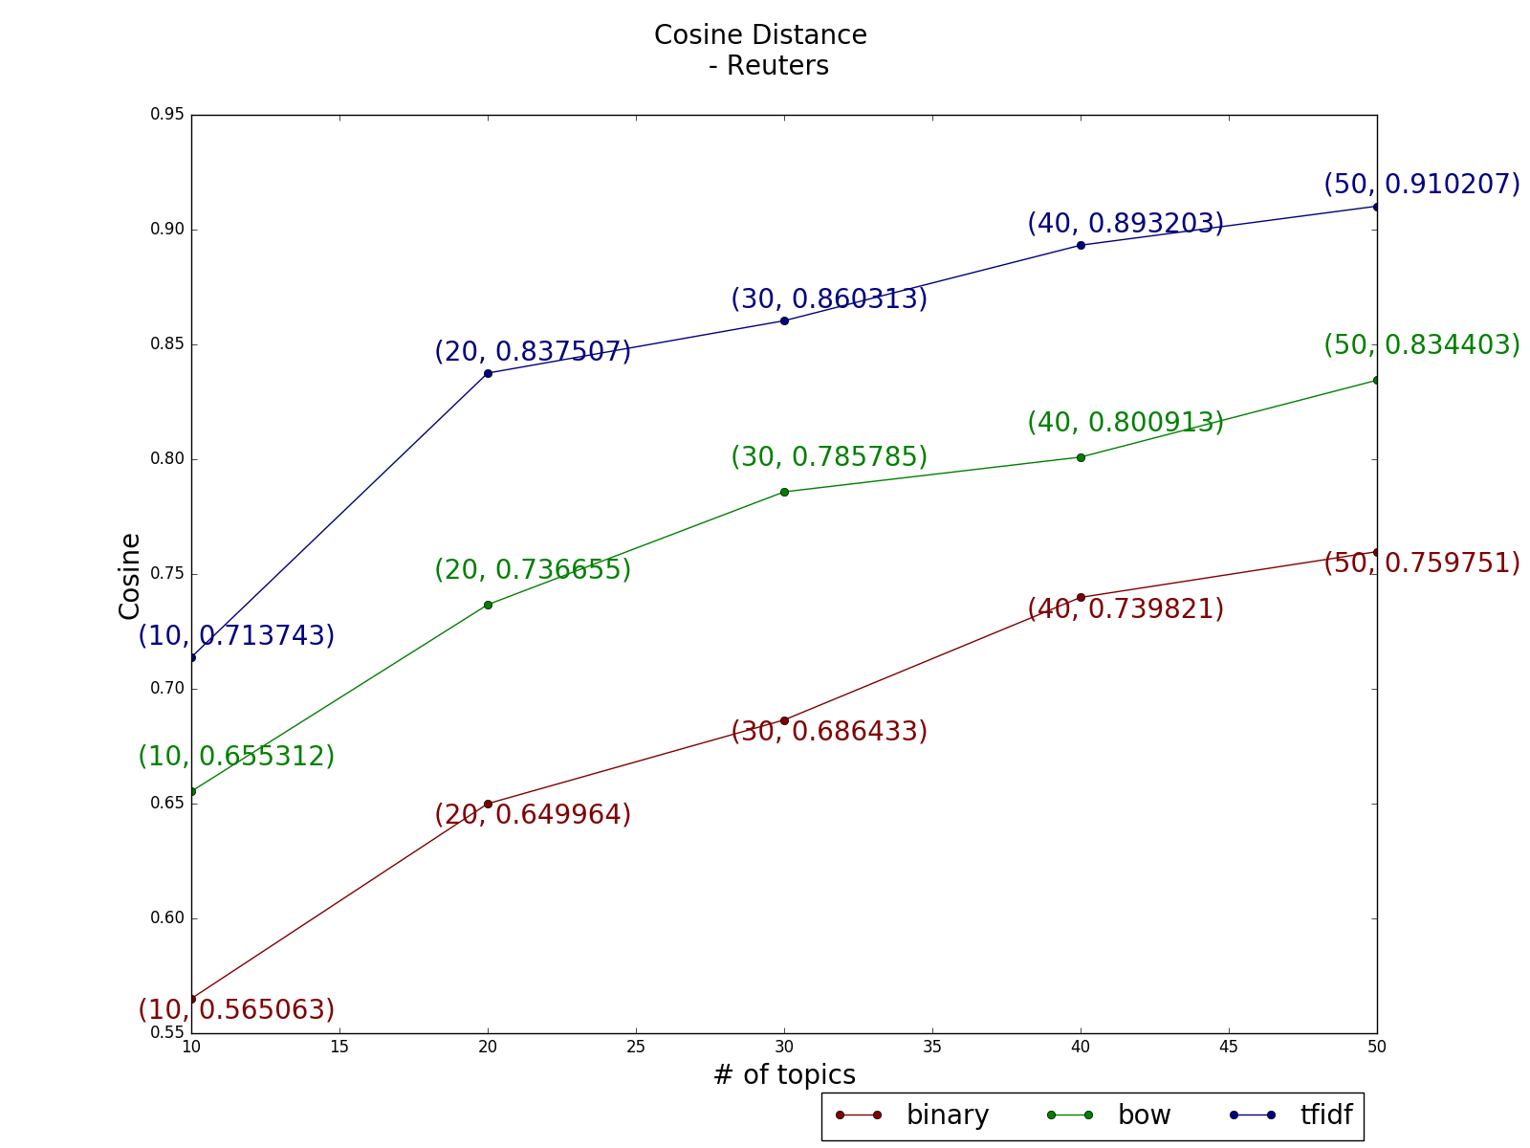
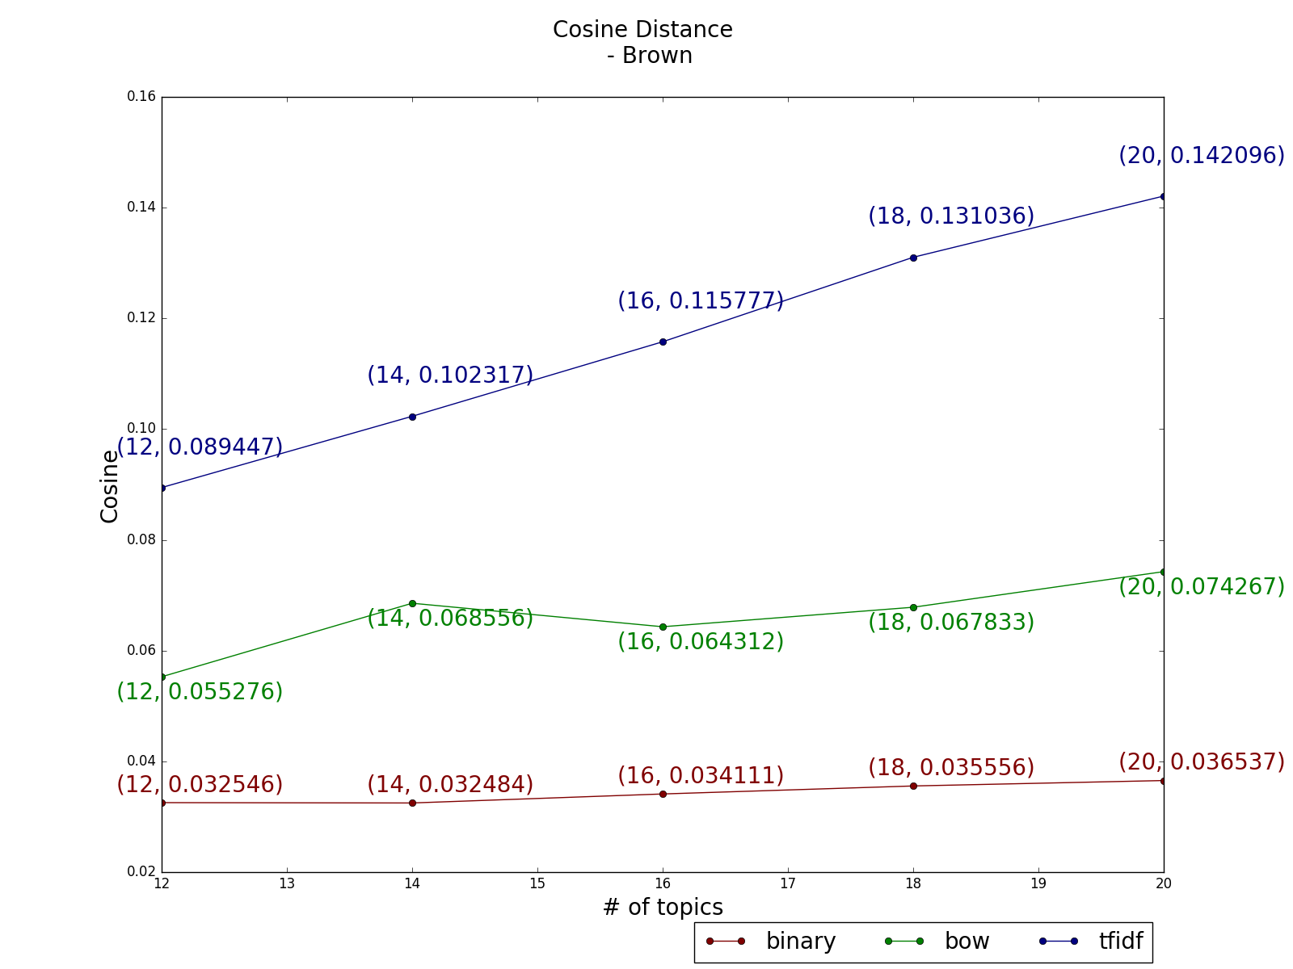
Distance Results
Topic as a vector over the vocabulary space – Cosine Distance
Distance | Reuters |  |  | Brown
# of topics increases | Increase | Increase | Increase | Steady | Almost Steady | Increase

Slide 62
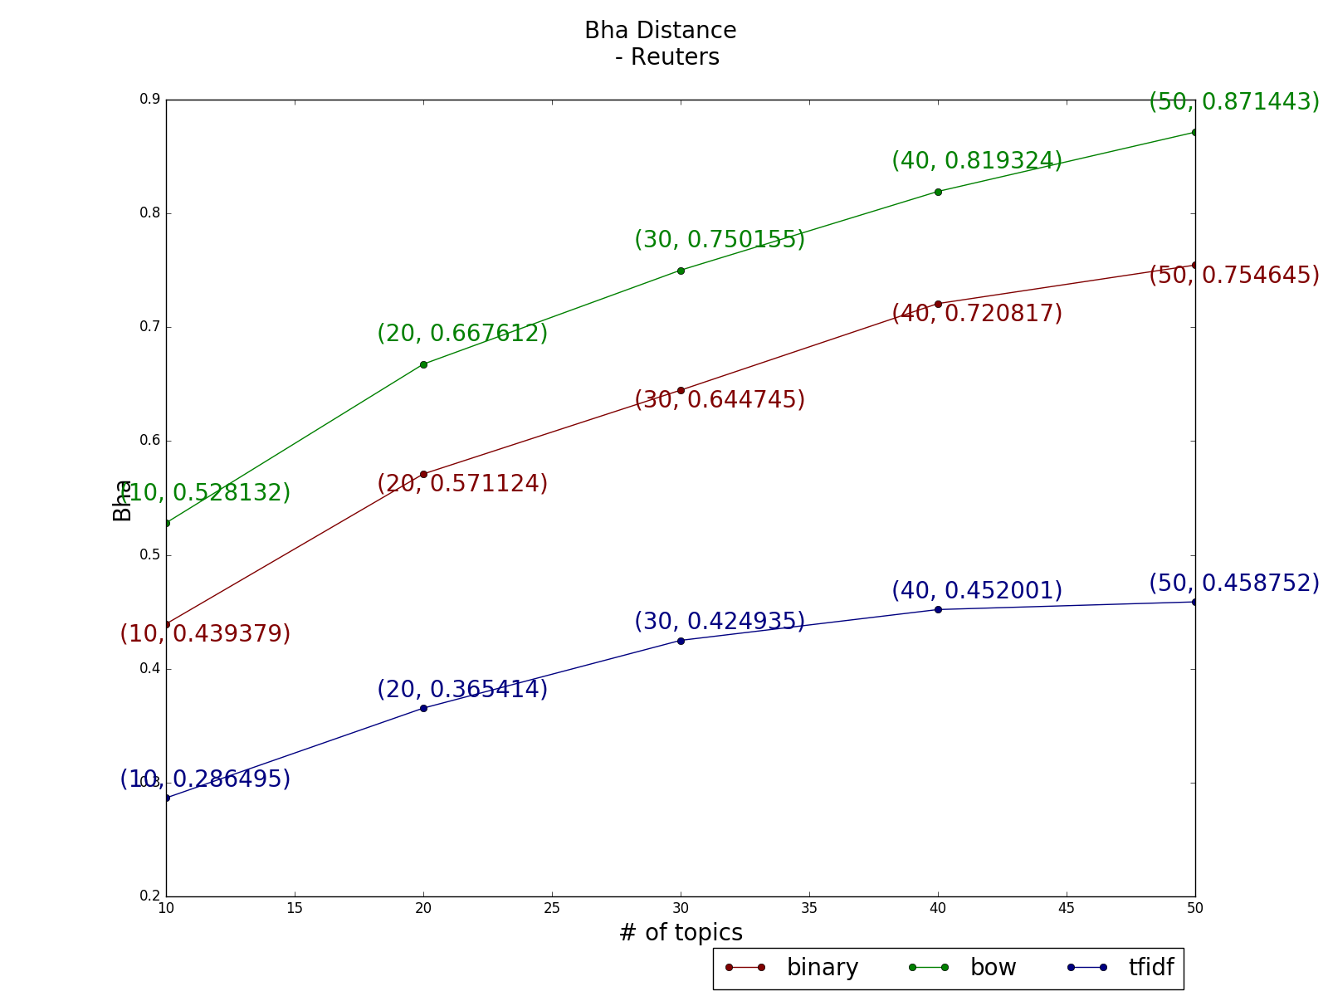
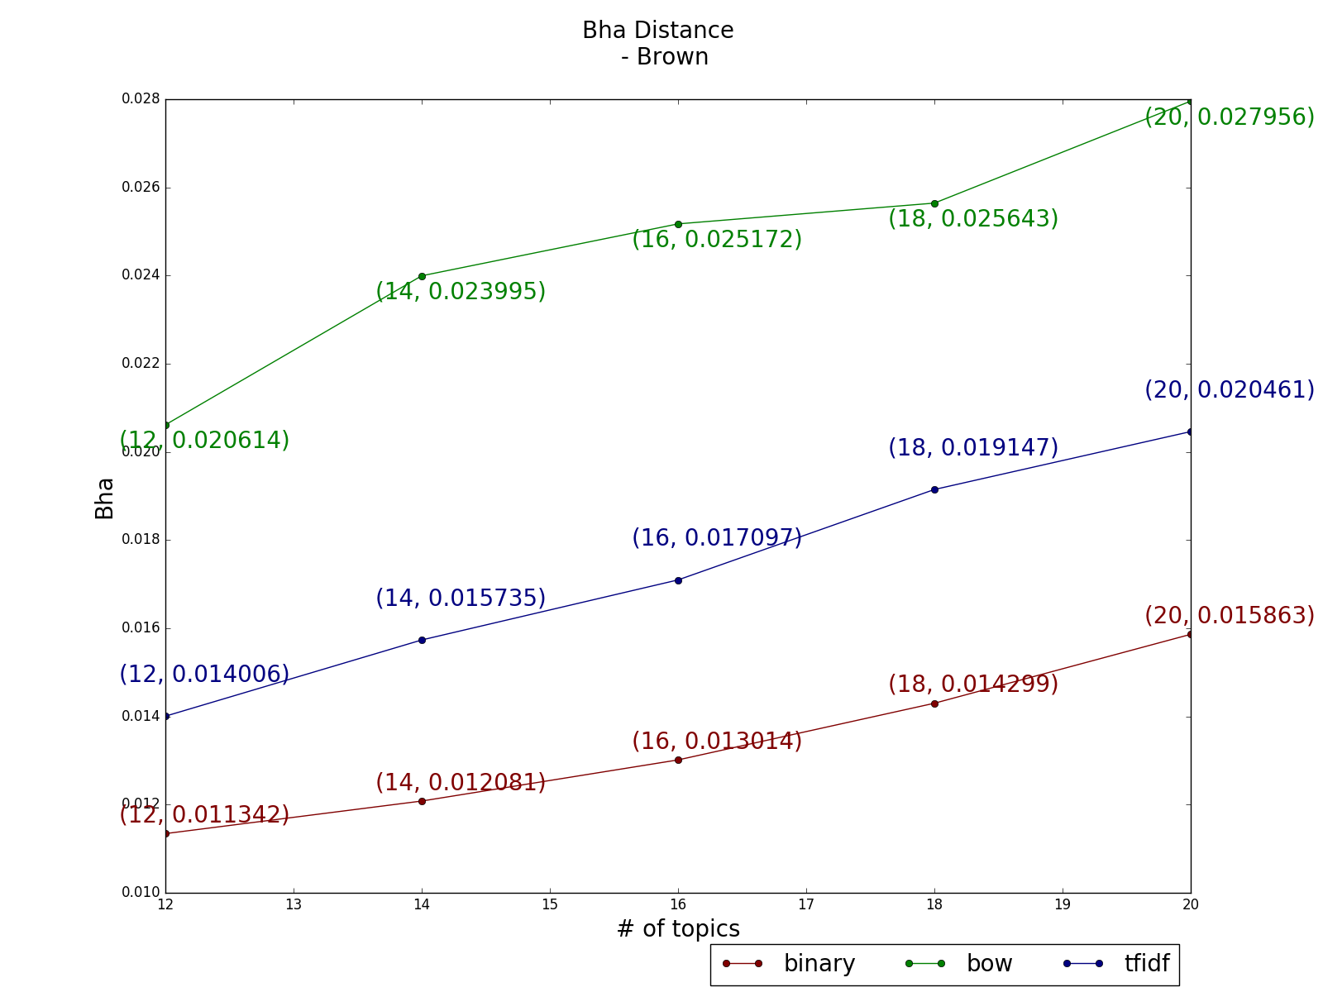
Distance Results
Topic as a distribution over words – Bha. Distance
Distance | Reuters |  |  | Brown
# of topics increases | Increase | Increase | Increase | Increase | Increase | Increase

Slide 63
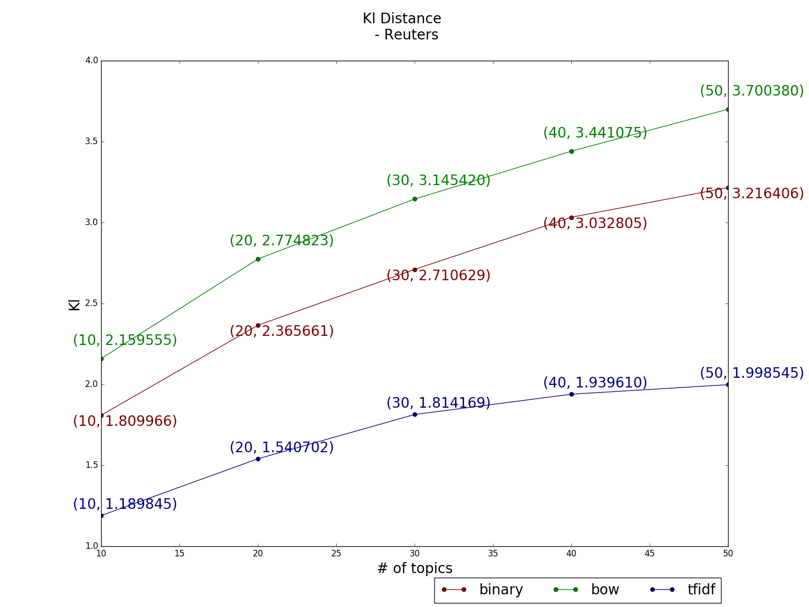
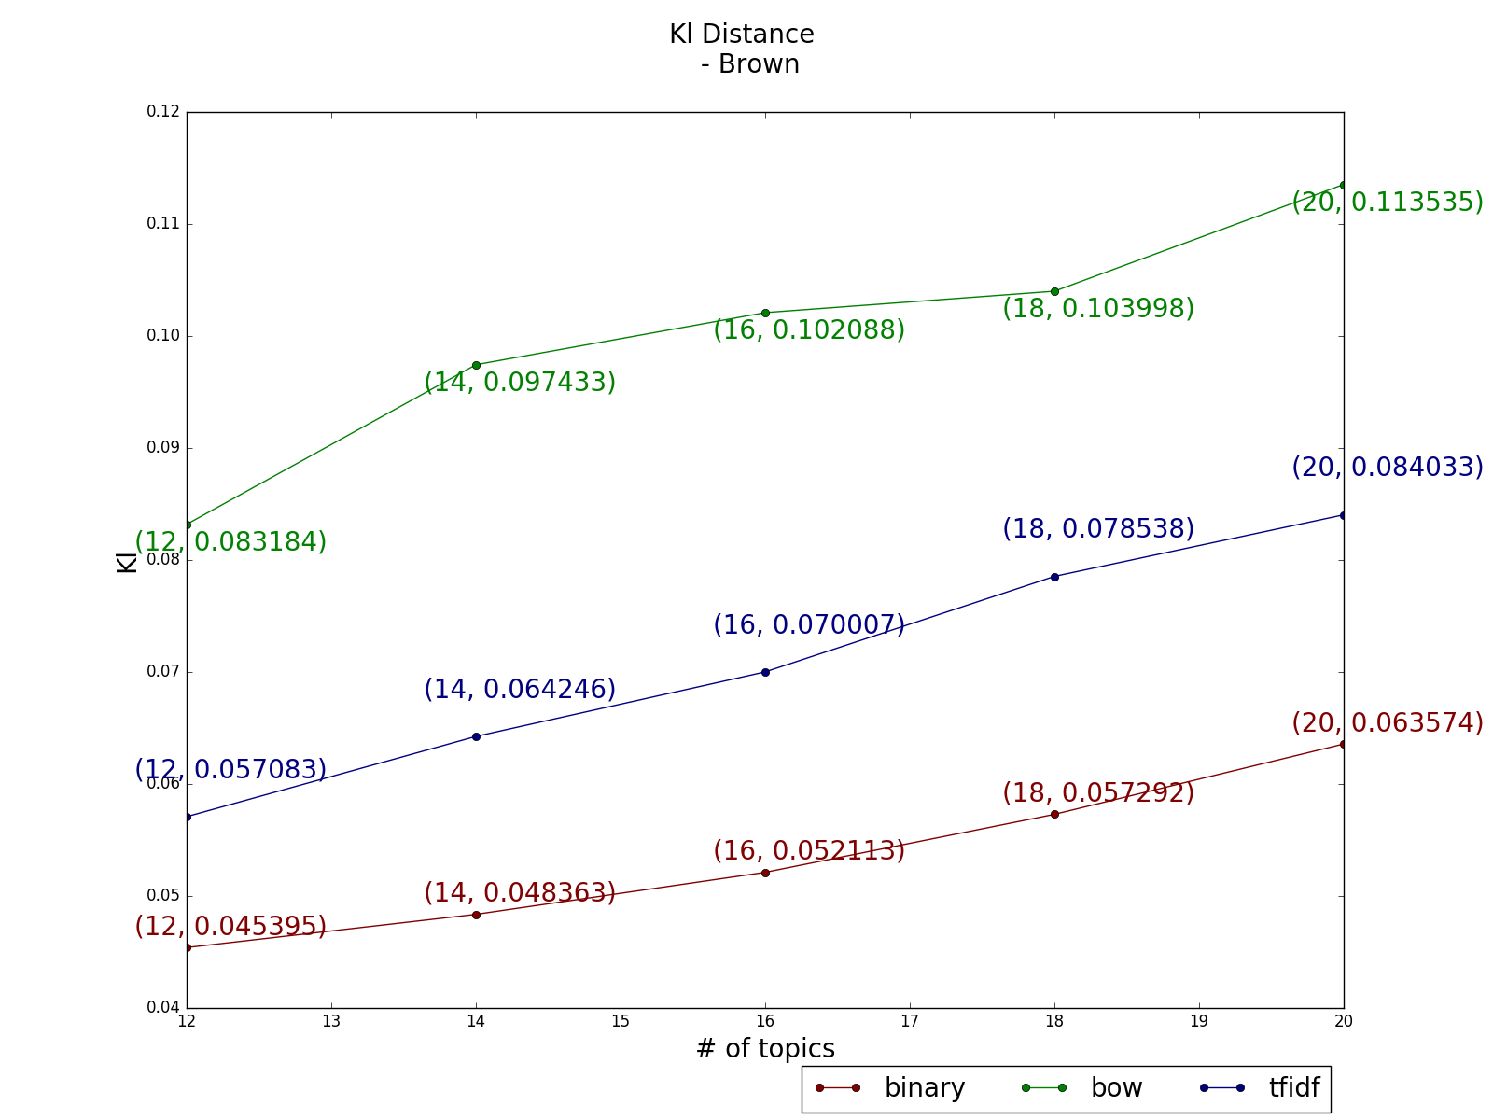
Distance Results
Topic as a distribution over words – KL Divergence
Distance | Reuters |  |  | Brown
# of topics increases | Increase | Increase | Increase | Increase | Increase | Increase

Slide 64
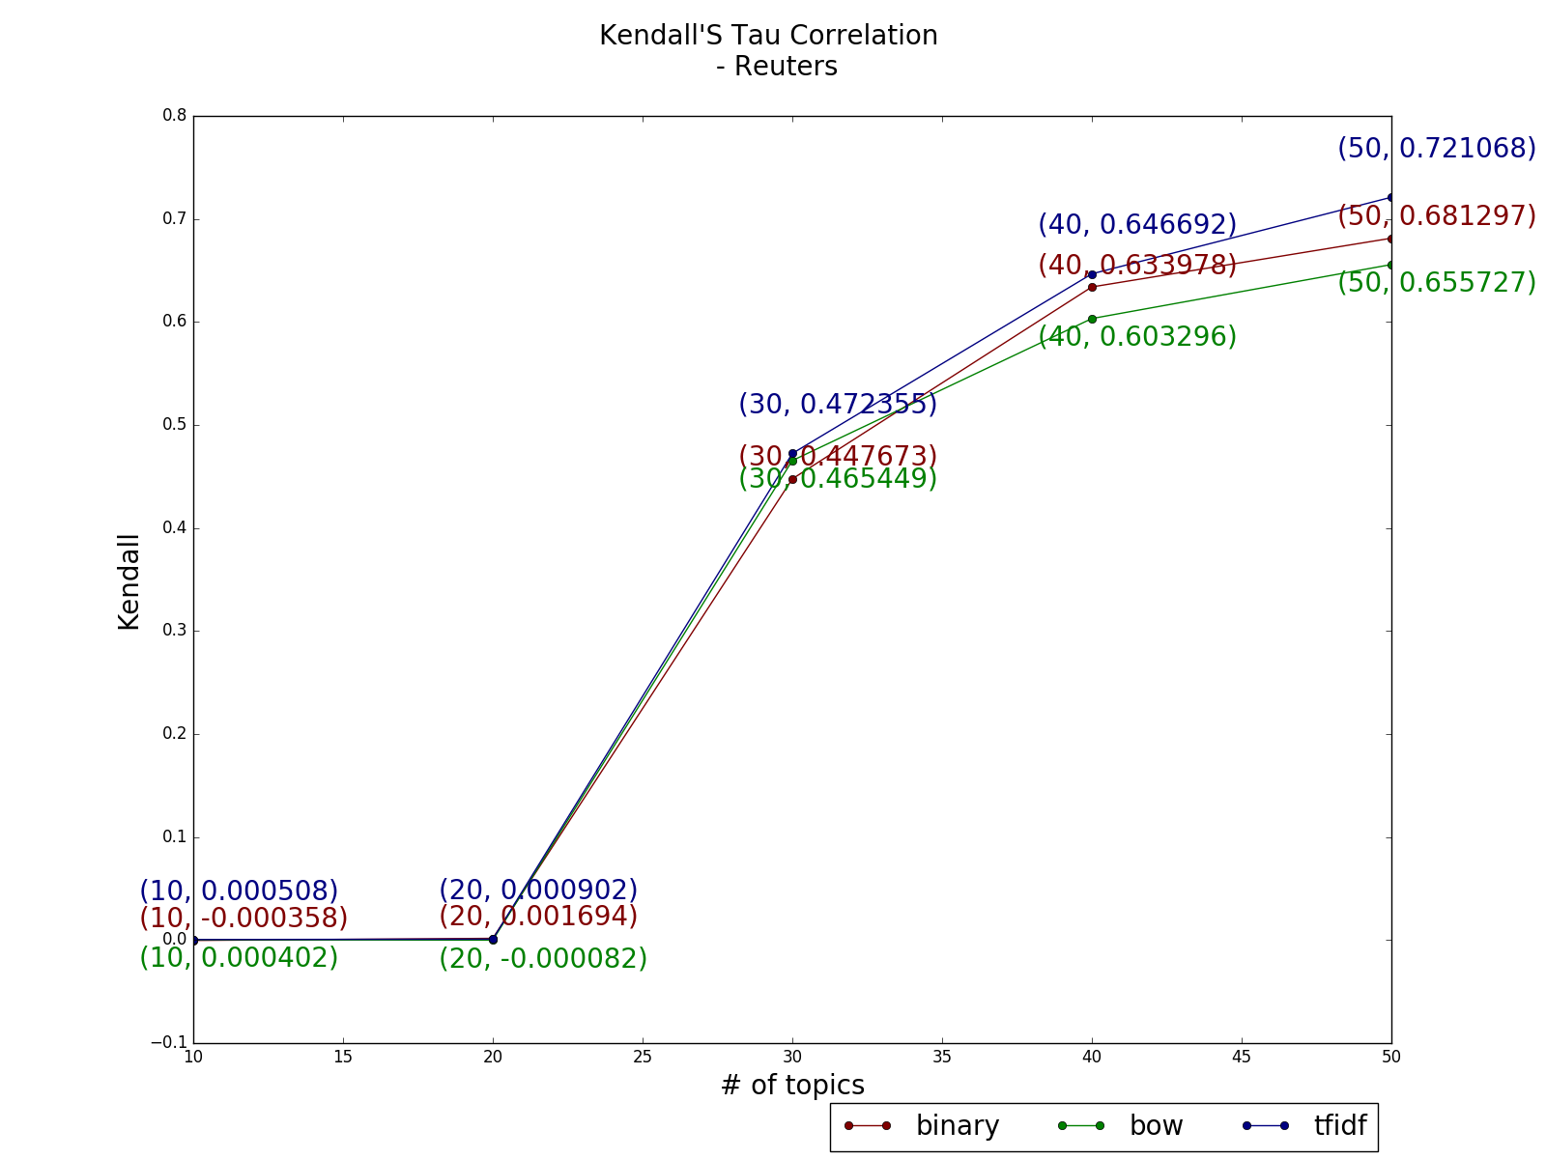
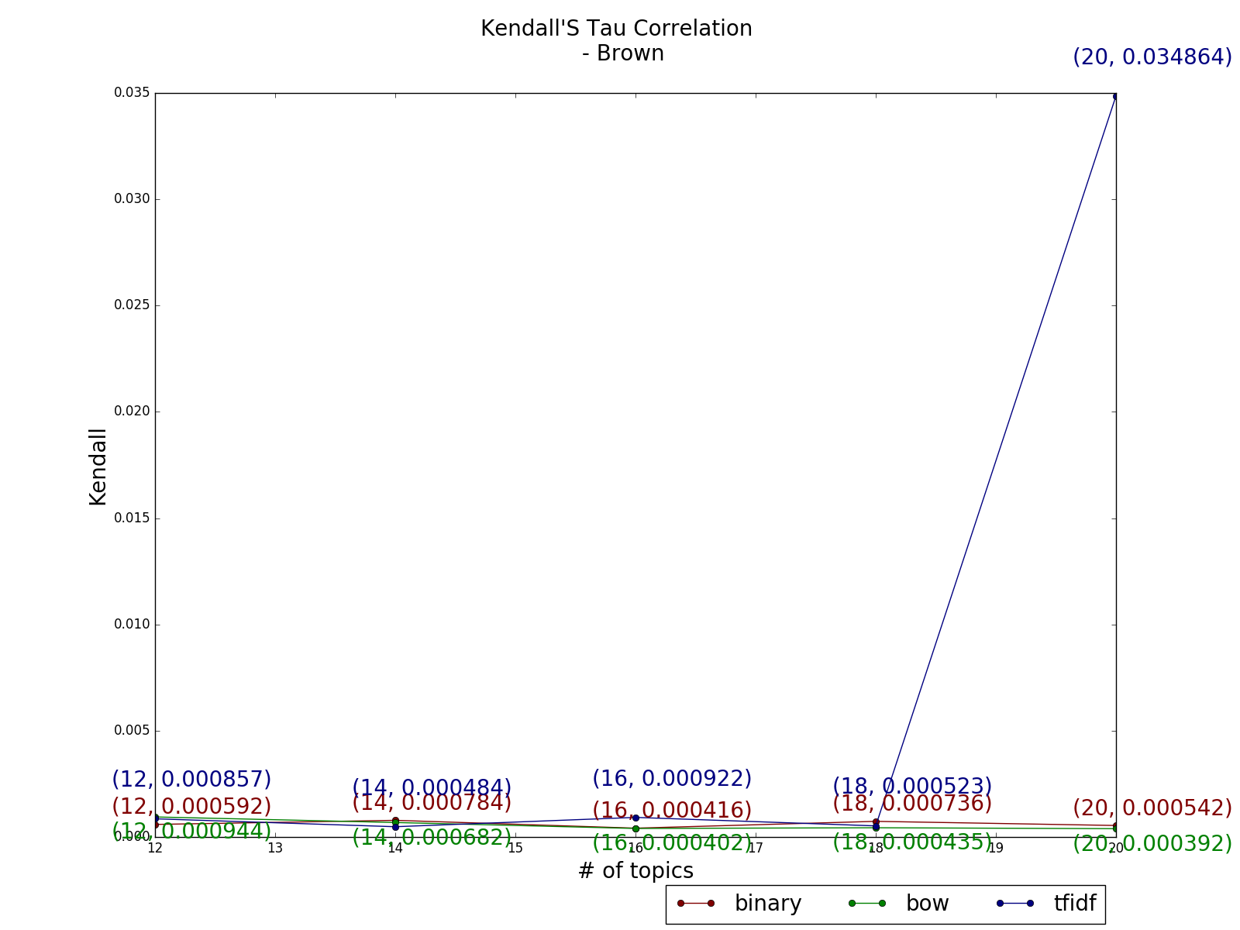
Distance Results
Topic as a ranked list of words – Kendall’s Tau Correlation (-1 to 1)
Similarity | Reuters |  |  | Brown
# of topics increases | Increase | Increase | Increase | Steady | Steady | Increase

Slide 65
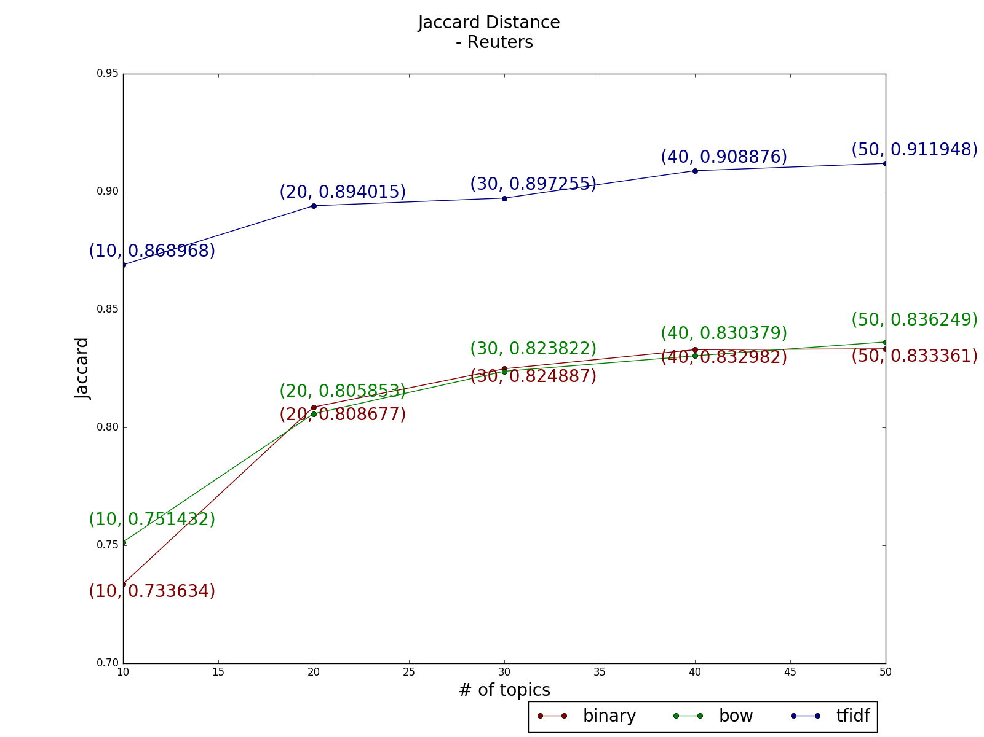
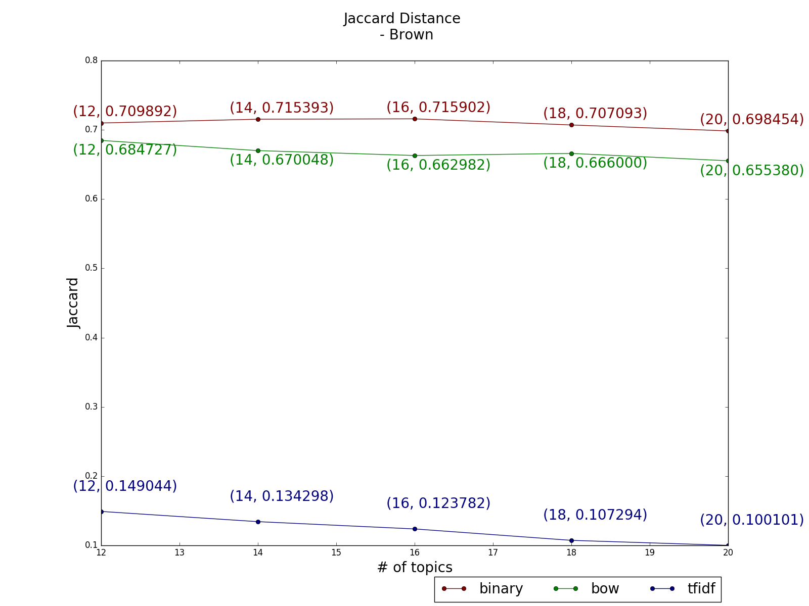
Distance Results
Topic as a set of words – Jaccard Distance
Distance | Reuters |  |  | Brown
# of topics increases | Increase | Increase | Increase | Steady | Steady | Decrease

Slide 66
Distance Results- Correlations among measures
Pearson correlation(all p<0.05) - Reuters
 | Cosine | Bha | KL | Jaccard | Kendall
Cosine |  | 0.167 | 0.131 | 0.760 | 0.331
Bha | 0.167 |  | 0.990 | -0.070 | 0.127
KL | 0.131 | 0.990 |  | -0.123 | 0.171
Jaccard | 0.760 | -0.070 | -0.123 |  | 0.304
Kendall | 0.331 | 0.127 | 0.171 | 0.304

Slide 67
Similarity Results - Correlations among measures
Kendall’s Tau Ranking Correlation(all p<0.05) - Reuters
 | Cosine | Bha | KL | Jaccard | Kendall
Cosine |  | -0.128 | -0.139 | 0.258 | 0.134
Bha | -0.128 |  | -0.191 | -0.121 | -0.056
KL | -0.139 | -0.191 |  | -0.117 | -0.044
Jaccard | 0.258 | -0.121 | -0.117 |  | 0.141
Kendall | 0.134 | -0.056 | -0.044 | 0.141

Slide 68
Similarity Results- Correlations among measures
Pearson correlation - Brown
 | Cosine | Bha | KL | Jaccard | Kendall
Cosine |  | **0.374 | **0.397 | ** -0.875 | **0.188
Bha | **0.374 |  | **1.000 | **0.046 | 0.038
KL | **0.397 | **1.000 |  | 0.022 | 0.042
Jaccard | ** -0.875 | **0.046 | 0.022 |  | ** -0.152
Kendall | **0.188 | 0.038 | 0.042 | ** -0.152
Note:
** : p < 0.05.
Bold : strong correlation

Slide 69
Similarity Results - Correlations among measures
Kendall’s Tau Ranking Correlation - Brown
 | Cosine | Bha | KL | Jaccard | Kendall
Cosine |  | **0.325 | **0.328 | **-0.658 | 0.019
Bha | **0.325 |  | **0.349 | **-0.333 | **-0.121
KL | **0.328 | **0.349 |  | **-0.341 | **-0.127
Jaccard | **-0.658 | **-0.333 | **-0.341 |  | -0.005
Kendall | 0.019 | **-0.121 | **-0.127 | -0.005
Note:
** : p < 0.05.
Bold : strong correlation

Slide 70
Outline
Background
Distance Experiments
Coherence Experiments
How number of top words influence coherence
How number of topics influence coherence
How corpus types influence coherence
Correlations among different measures
Discussion

Slide 71
Coherence Experiment
Corpora | Reuters, Brown
Numbers of Topics: | 5,10,15,20
Numbers of Top Words | 5, 10, 15, … 150
Corpus Type: | Tfidf, Bow, Binary
Measures: | Co-occurrence based coherence Measure Tfidf Co-occurrence based coherence Measure WordNet coherence measures

Slide 72
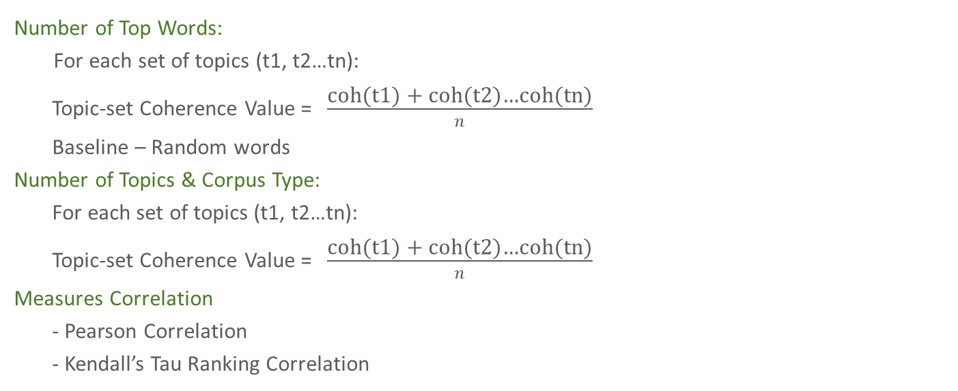
Coherence Experiment
Number of Top Words:
For each set of topics (t1, t2…tn):
Topic-set Coherence Value = $\frac{\text{coh}\text{(}\text{t}\text{1}\text{) + }\text{coh}\text{(}\text{t}\text{2}\text{)}\text{…}\text{coh}\text{(}\text{tn}\text{)}}{n}$
Baseline – Random words
Number of Topics & Corpus Type:
For each set of topics (t1, t2…tn):
Topic-set Coherence Value = $\frac{\text{coh}\text{(}\text{t}\text{1}\text{) + }\text{coh}\text{(}\text{t}\text{2}\text{)}\text{…}\text{coh}\text{(}\text{tn}\text{)}}{n}$
Measures Correlation
- Pearson Correlation
- Kendall’s Tau Ranking Correlation
Notes:
Topic set coherence value is defined as the average of coherence values of topics

Slide 73
Coherence Experiment
Coherent Topic
TC: -70.089
bank : 0.0279657465152
rate : 0.023811830955
pct : 0.0156586442573
dollar : 0.0134510791657
market : 0.0132709087771
currency : 0.00921212587181
u.s. : 0.00859911745669
exchange : 0.00802242679236
cut : 0.00696400103261
mark : 0.00672299580672
Incoherence Topic
TC: -149.210028238
three-for-two : 0.00510543190802
pct : 0.00441486771091
rise : 0.00413571122315
february : 0.00403229866795
january : 0.00330294977387
writedown : 0.00293321731826
africa : 0.00290027441263
mthly : 0.00289415081164
rand : 0.00283650905673
year-on-year : 0.00256394193525

Slide 74
Outline
Background
Distance Experiments
Coherence Experiments
How number of top words influence coherence
How number of topics influence coherence
How corpus types influence coherence
Correlations among different measures
Discussion

Slide 75
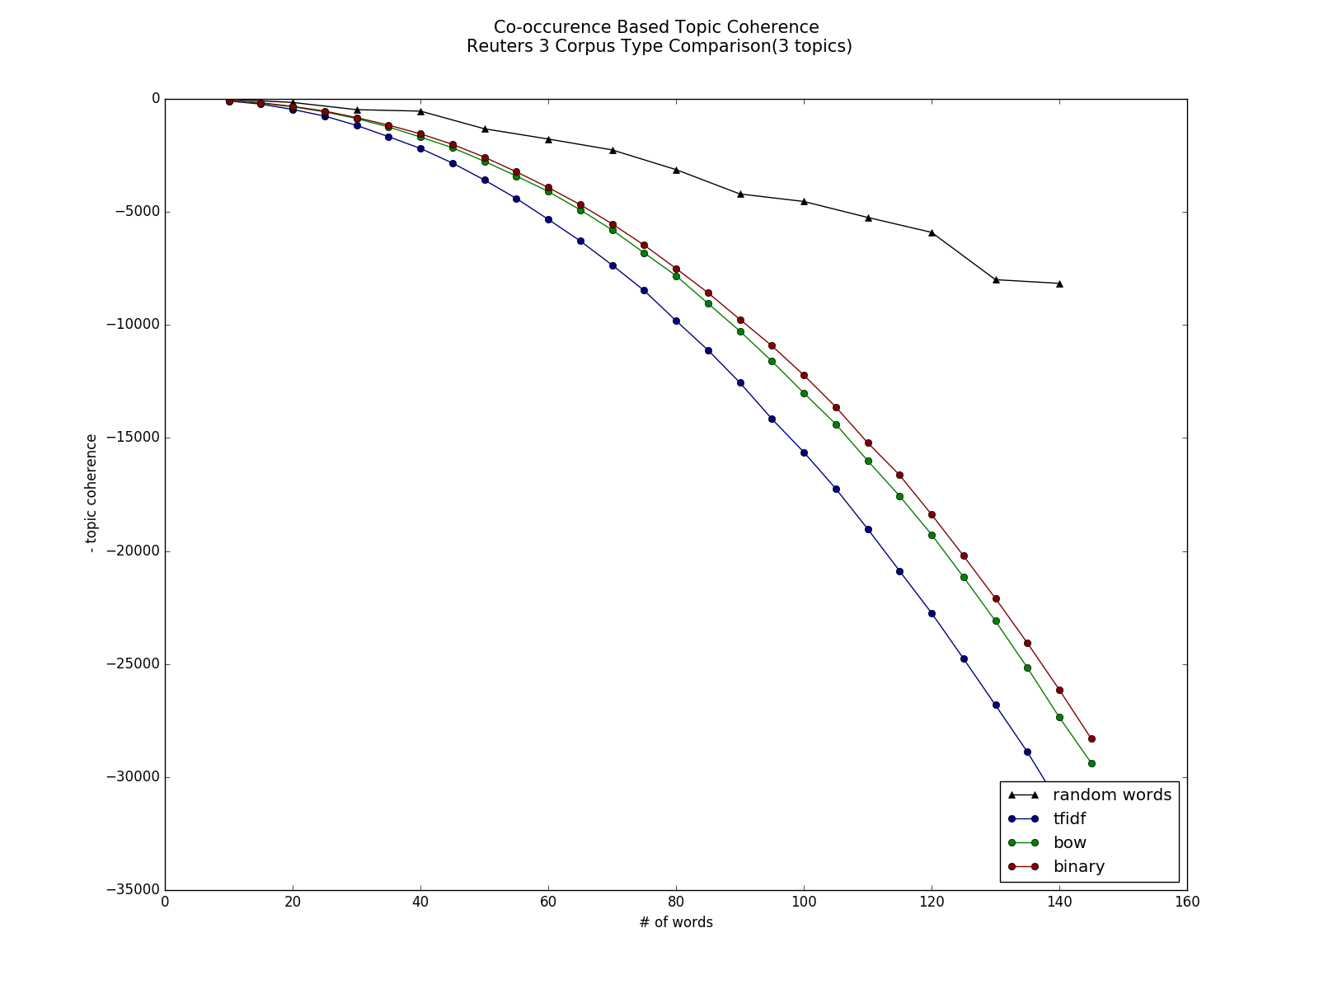
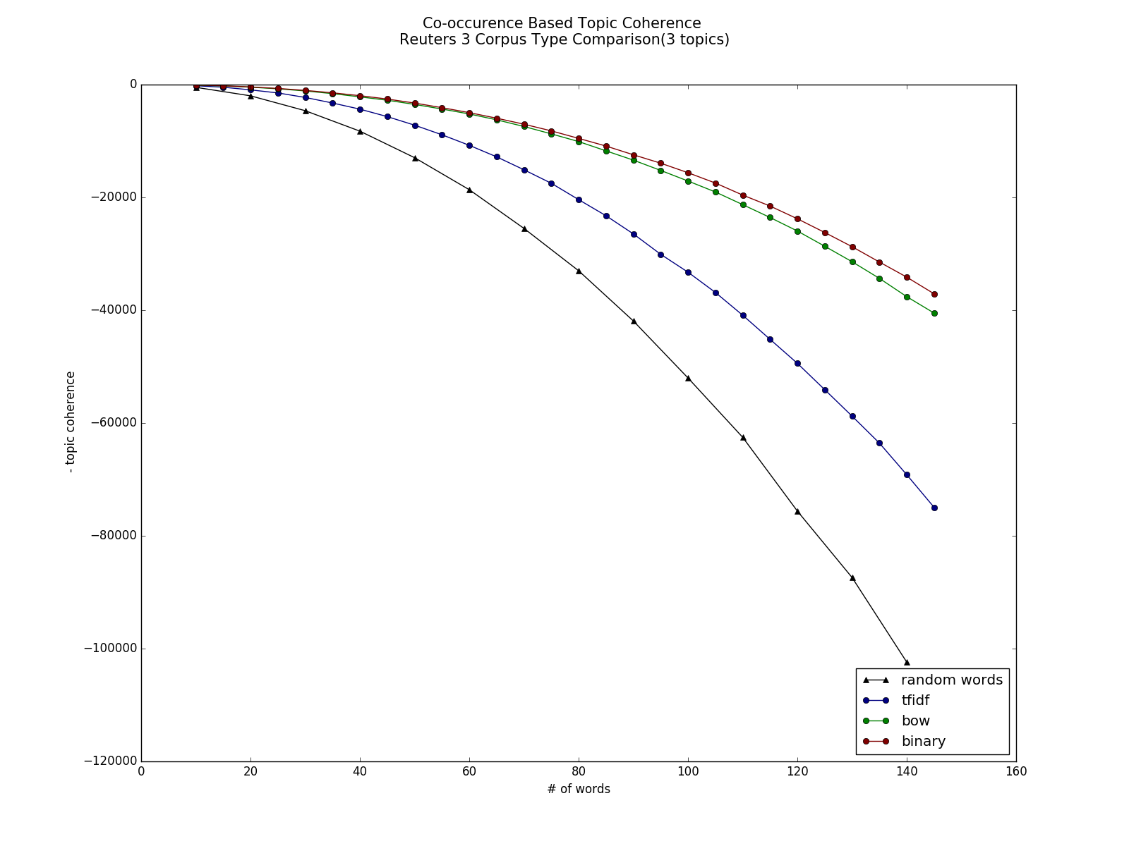
Coherence Results – Co-occurence
The number of top words does not influence coherence
Word pair co-occurrence contribution =
Most time this is negative
Notes:
Because TC is a summarization function, as number of words increases, coherence value will become more negative
We want to know about the slope of the decrease
If word pair co-occurrence contribution does not become more negative as number of words increase, according to the equation, the increase should be quadratic.
However if as number of words increases, two words become less related, we expect word pair contribution to be more negative. And we expect the absolute value of the slope to be larger than 2

Slide 76
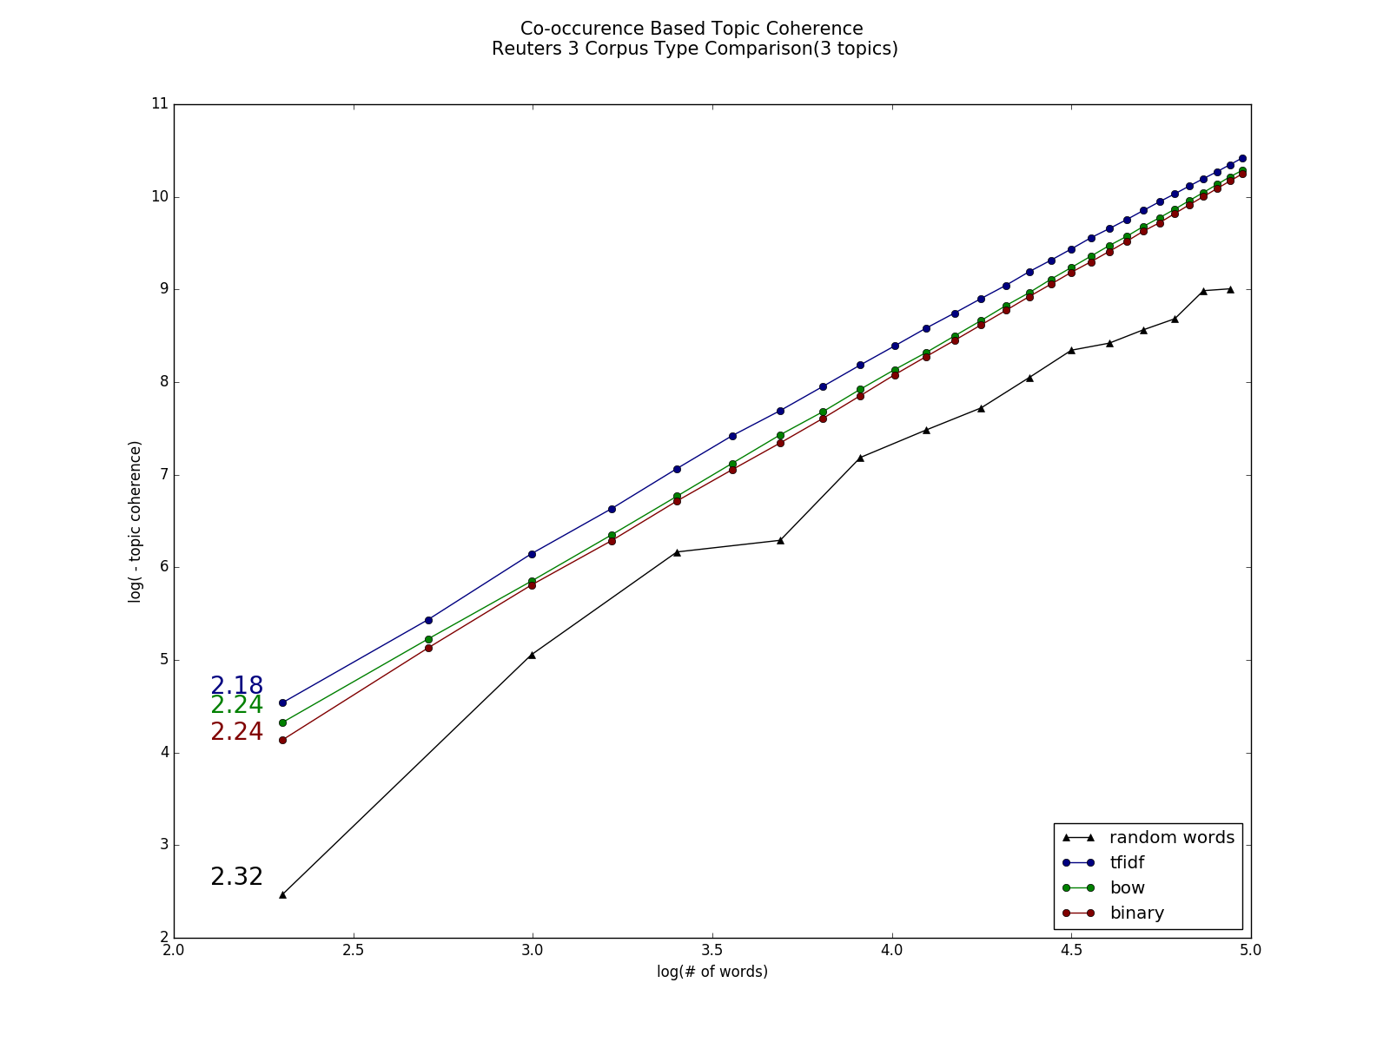
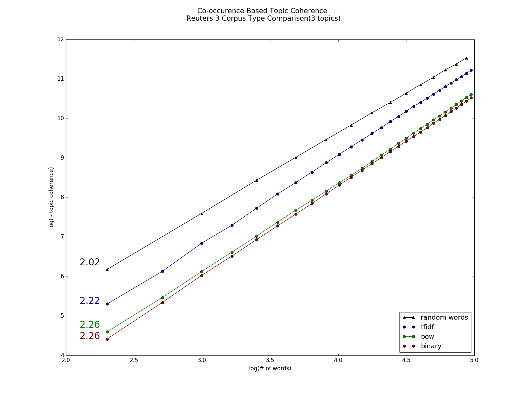
Coherence Results – Co-occurence
Coherence value gradually becomes negative
Word pair co-occurrence contribution =
Notes:
Linear correlation
Slope

Slide 77
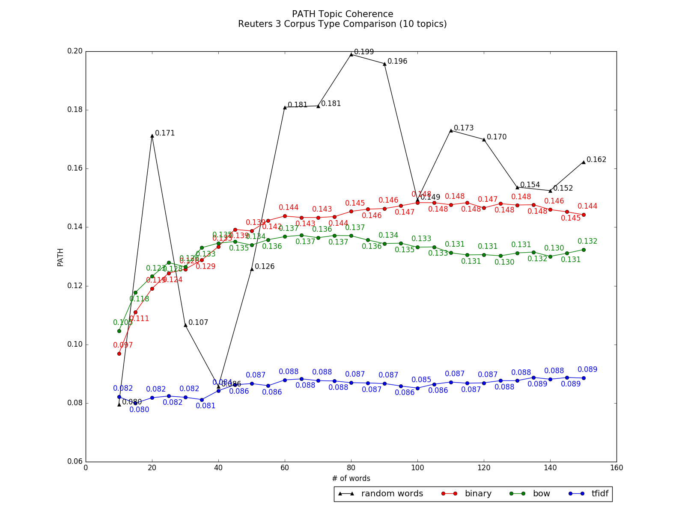
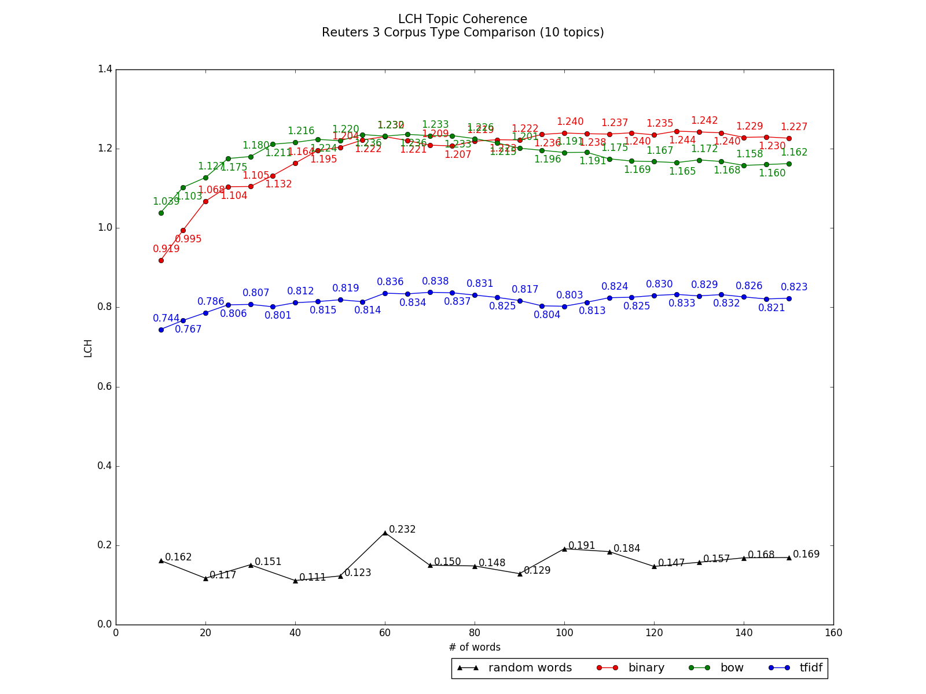
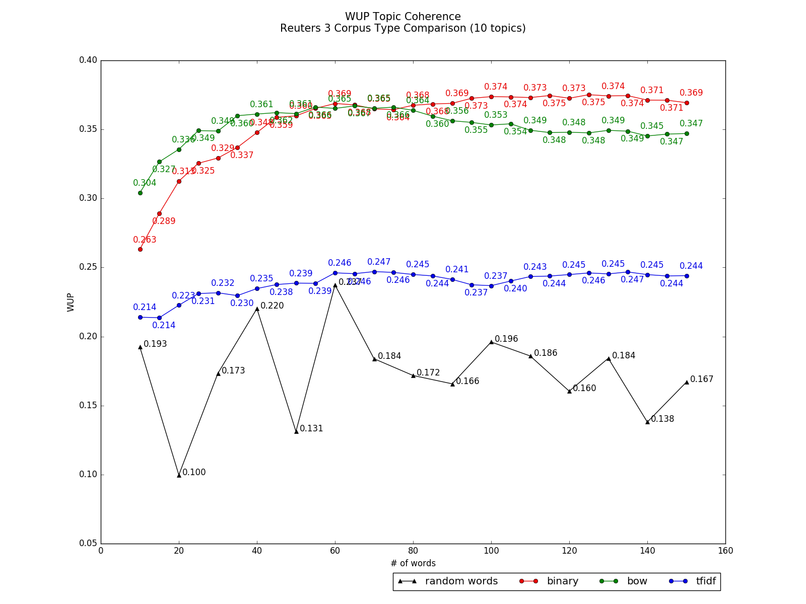
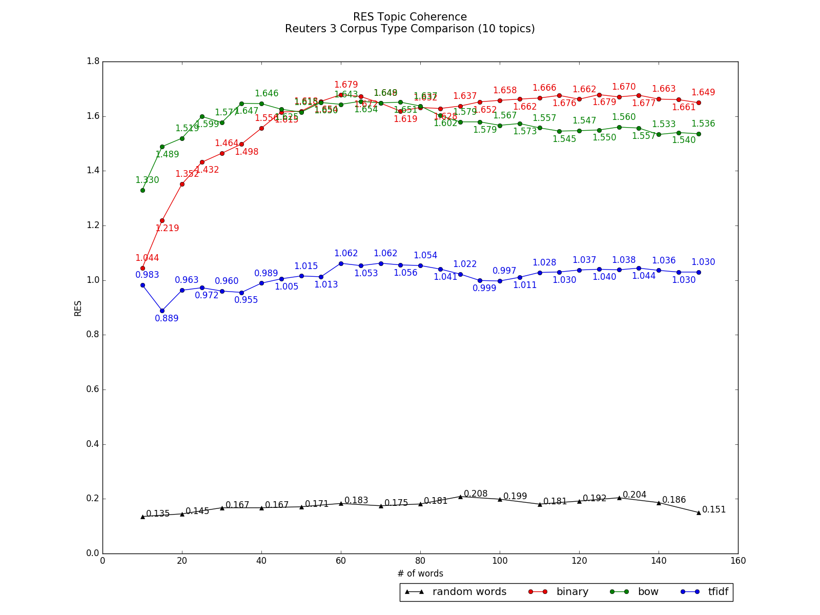
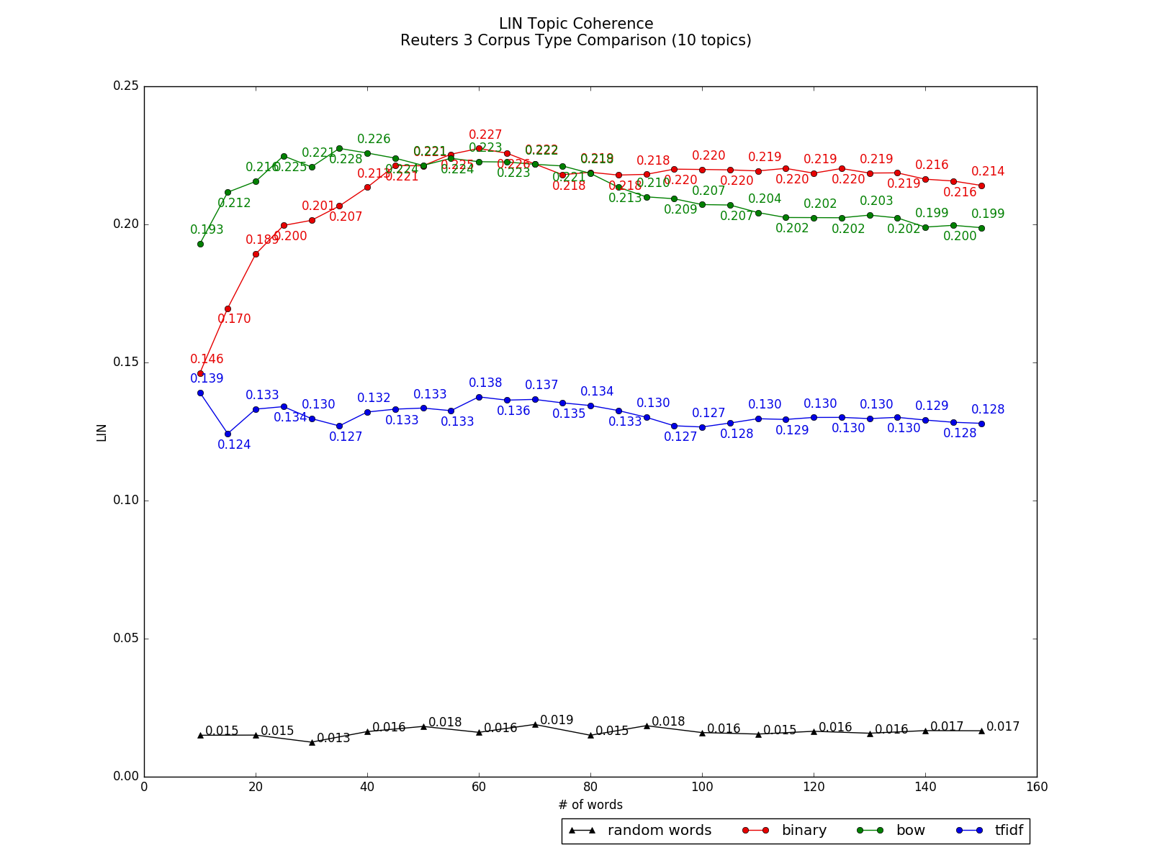
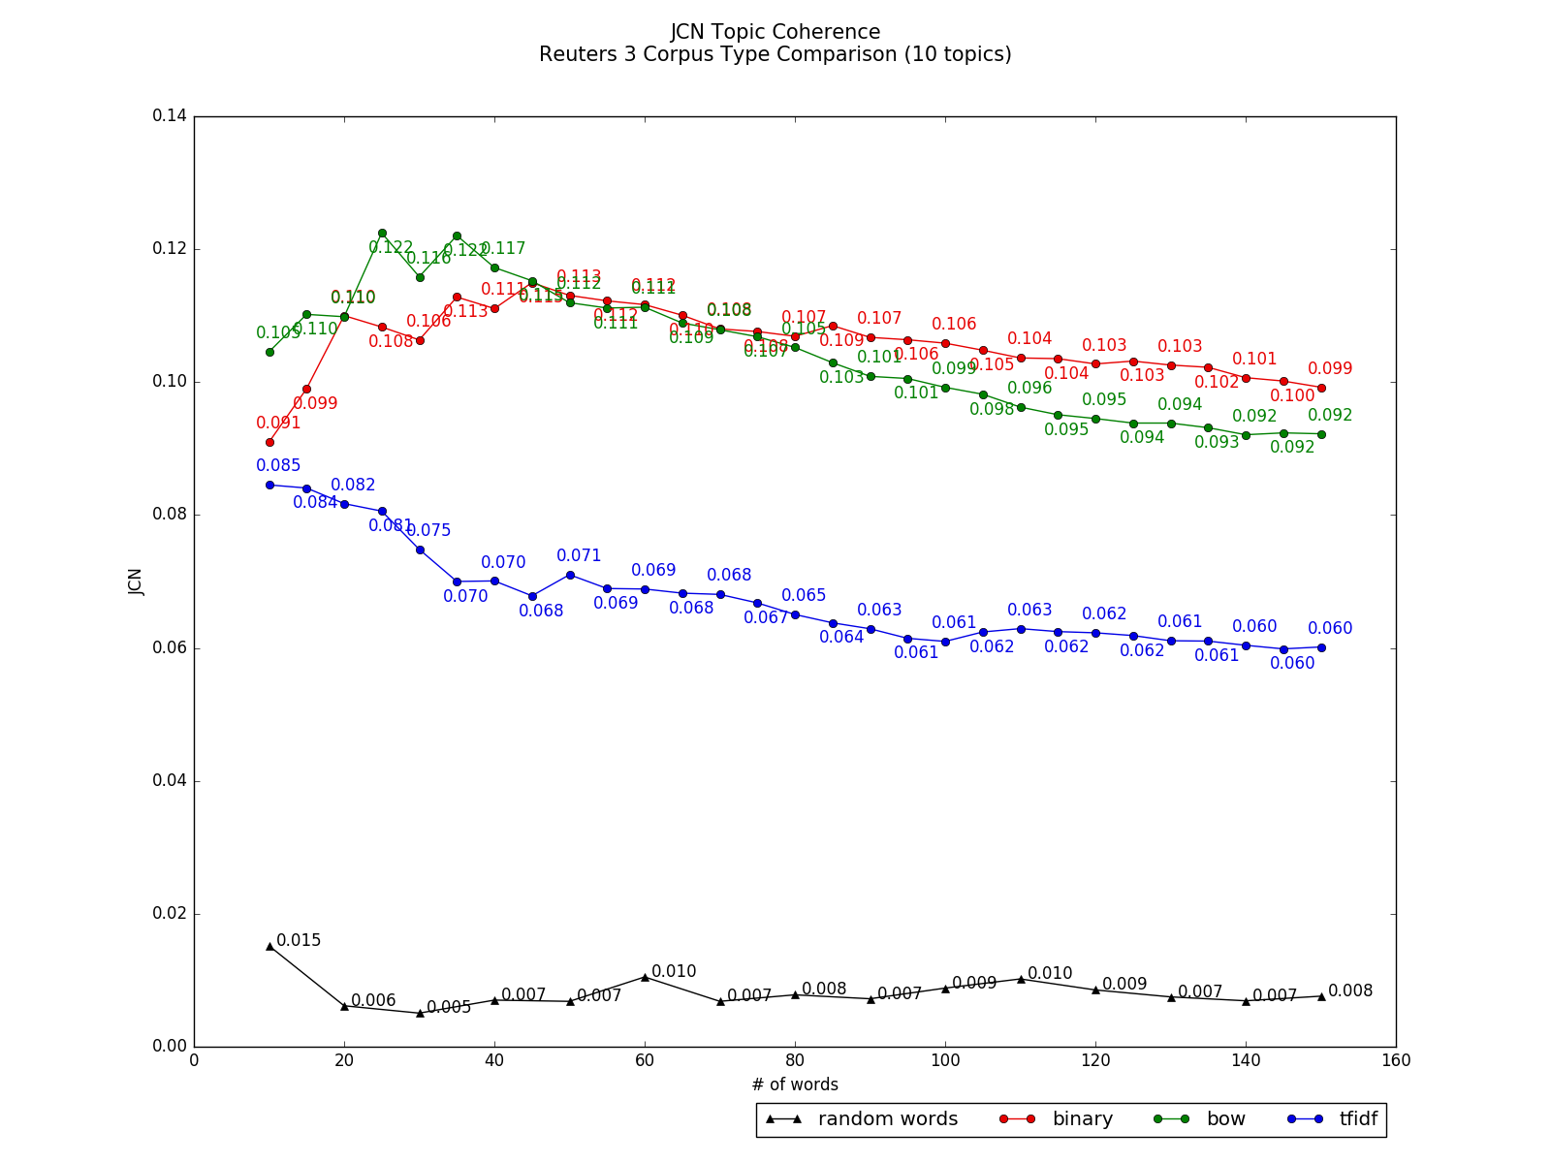
Coherence Results – WordNet (mean)
Binary & Bow Corpus: After 40 - 60 top words – steady

Slide 78






Coherence Results – WordNet (median)
Binary & Bow Corpus: 40 - 60 top words have the best coherence

Slide 79
Outline
Background
Distance Experiments
Coherence Experiments
How number of top words influence coherence
How number of topics influence coherence
How corpus types influence coherence
Correlations among different measures
Discussion

Slide 80


Coherence Results - Co-occurrence
 | Reuters |  |  | Brown
# of topics increases | Decrease | Decrease | Decrease then Increase | Steady | Steady | Increase

Slide 81


Coherence Results – Tfidf Co-occurrence
 | Reuters |  |  | Brown
# of topics increases | Decrease | Decrease | Decrease then Increase | Steady | Steady | Decrease
Notes:
For bow – Brown has better coherence values for tfidf - Reuters has better coherence values

Slide 82






Coherence Results – WordNet (Reuters Mean)

Slide 83






Coherence Results – WordNet (Reuters Median)

Slide 84






Coherence Results – WordNet (Brown Mean)
For tfidf, as topic number increases, coherence decreases

Slide 85






Coherence Results – WordNet (Brown Median)
For tfidf, as topic number increases, coherence decreases

Slide 86
Outline
Background
Distance Experiments
Coherence Experiments
How number of top words influence coherence
How number of topics influence coherence
How corpus type influence coherence
Correlations among different measures
Discussion

Slide 87
Coherence Results- Correlation among Measures
Pearson Correlation
 | TC | Tfidf-TC | PATH | LCH | WUP | RES | LIN | JCN
TC |  | **0.381 | 0.000 | 0.081 | 0.006 | 0.003 | -0.006 | -0.003
Tfidf-TC | **0.381 |  | 0.026 | 0.0625 | 0.047 | 0.018 | 0.019 | 0.023
PATH | 0.000 | 0.026 |  | **0.910 | **0.978 | **0.975 | **0.978 | **0.879
LCH | 0.081 | 0.0625 | **0.910 |  | **0.912 | **0.913 | **0.907 | **0.795
WUP | 0.006 | 0.047 | **0.978 | **0.912 |  | **0.982 | **0.983 | **0.885
RES | 0.003 | 0.018 | **0.975 | **0.913 | **0.982 |  | **0.994 | **0.887
LIN | -0.006 | 0.019 | **0.978 | **0.907 | **0.983 | **0.994 |  | **0.914
JCN | -0.003 | 0.023 | **0.879 | **0.795 | **0.885 | **0.887 | **0.914
Note:
** : p < 0.05.
Bold : strong correlation

Slide 88
Coherence Results- Correlation among Measures
Kendall’s Tau Correlation (all p < 0.05 )
 | TC | Tfidf-TC | PATH | LCH | WUP | RES | LIN | JCN
TC |  | 0.165 | 0.445 | 0.427 | 0.422 | 0.421 | 0.437 | 0.348
Tfidf-TC | 0.165 |  | -0.327 | 0.314 | 0.320 | 0.288 | 0.310 | 0.159
PATH | 0.445 | -0.327 |  | 0.473 | 0.460 | 0.510 | 0.483 | 0.382
LCH | 0.427 | 0.314 | 0.473 |  | 0.462 | 0.499 | 0.487 | 0.289
WUP | 0.422 | 0.320 | 0.460 | 0.462 |  | 0.496 | 0.447 | 0.318
RES | 0.421 | 0.288 | 0.510 | 0.499 | 0.496 |  | 0.480 | 0.337
LIN | 0.437 | 0.310 | 0.483 | 0.487 | 0.447 | 0.480 |  | 0.289
JCN | 0.348 | 0.159 | 0.382 | 0.289 | 0.318 | 0.337 | 0.289

Slide 89
Outline
Background
Distance Experiments
Coherence Experiments
Discussion
Summarization
Limitations
Future Direction

Slide 90
Summarization
 | Distance | Coherence
Corpus Type | Bow | Binary, Bow
Increase Number of Topics | Increase(Vector, Distribution) Inconsistent(Set, Ranking) | Overall: Less increase Tfidf: Decrase > Increase
Increase Number of Top Words |  | WordNet Binary & Bow: 40-60 words

Slide 91
Limitations
1. Topic numbers are small. Some past research tested topic numbers 100+
2. The range of topic numbers is small.
3. For WordNet coherence measures,
- some words in the corpus are not in WordNet
- some word pairs are not related
Pairs of words | Reuters | Brown
One word is not in WordNet | 20% pairs | 12% pairs
No distance | 1% pairs | 1% pairs

Slide 92
Future Directions
Overall
Use larger number of topics and a larger range of topics
Distance
Why would Jaccard Distance and Cosine Distance have a strong positive correlation in reuters and a strong negative correlation in brown

Slide 93
Future Directions
Coherence
1. Tfidf performs poorly
Is tfidf a good choice for LDA?
Would topic coherence measures prefer common/frequent words?
More coherence measures
2. Instead of coherence measures, topic models have many applications
classification, relevance judgment, summarization …
How would the number of top words, topic numbers and corpus types influence these applications?
3. For co-occurrence based coherence measure, why would random words have better coherence values?

Slide 94
References
Latent Dirichlet Allocation http://www.jmlr.org/papers/volume3/blei03a/blei03a.pdf
Latent Dirichlet Allocation David Blei Lectures http://videolectures.net/mlss09uk_blei_tm/
Introduction to Latent Dirichlet Allocation http://blog.echen.me/2011/08/22/introduction-to-latent-dirichlet-allocation/
Probabilistic Topic Model
https://www.cs.princeton.edu/~blei/papers/Blei2012.pdf
Automatic Evaluation of Topic Coherence https://mimno.infosci.cornell.edu/info6150/readings/N10-1012.pdf
Optimizing Semantic Coherence in Topic Models http://dirichlet.net/pdf/mimno11optimizing.pdf
Topic Chains for Understanding a New Corpus http://uilab.kaist.ac.kr/research/CICLING2011/paper.pdf
WordNet https://wordnet.princeton.edu/
Measuring Topic Qualities in Latent Dirichlet Allocation http://logic.pdmi.ras.ru/~sergey/slides/N14_PhMLtalk.pdf
Topic Model Image http://lca.epfl.ch/student-projects/projects/2013-09-autumn/topic_models_geotagged_tweets.html
LDA Graphics Model Image https://filebox.ece.vt.edu/~s14ece6504/projects/alfadda_topic/index.html
Vector Space Model Image https://en.wikipedia.org/wiki/Vector_space_model
Cosine Similarity Image https://alexn.org/blog/2012/01/16/cosine-similarity-euclidean-distance.html

Slide 95
Questions?

